Slide 1

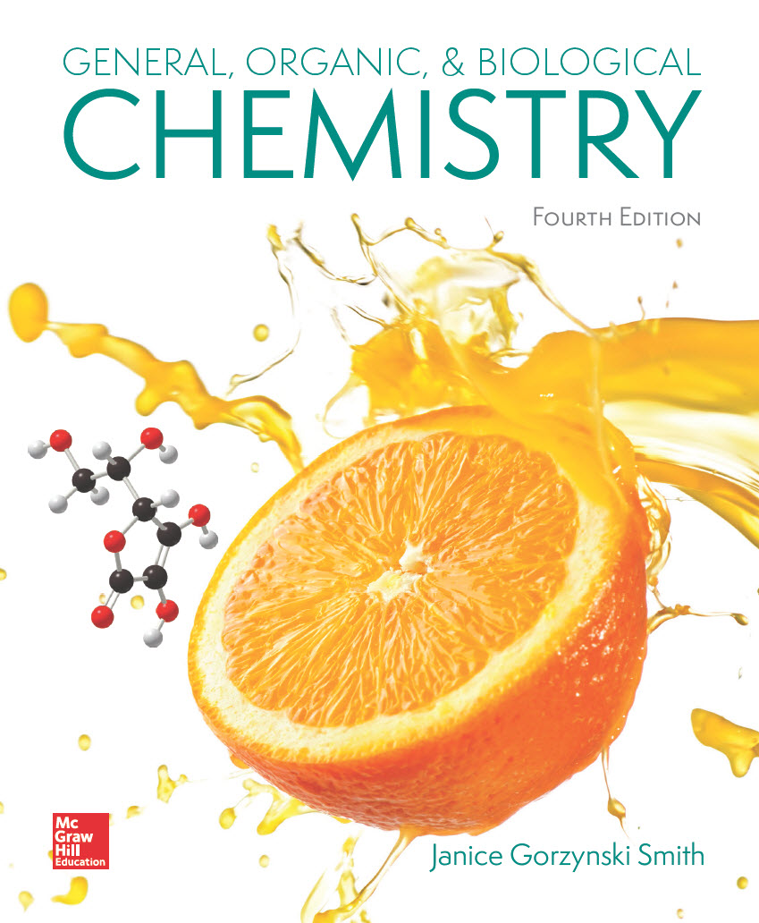
Chapter 13
Lecture Outline
Prepared by
Harpreet Malhotra
Florida State College at Jacksonville

Slide 2
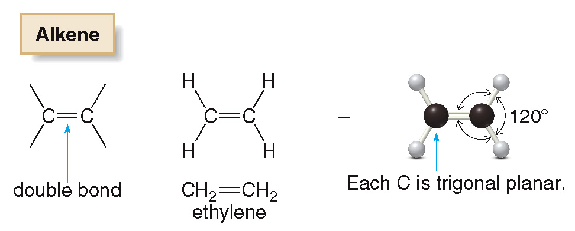
13.1 Alkenes and Alkynes (1)
Alkenes and alkynes are two families of organic molecules that contain multiple bonds.
Alkenes are compounds that contain a carbon−carbon double bond.
Alkenes have the general formula C_{n}H_{2n}.

Slide 3
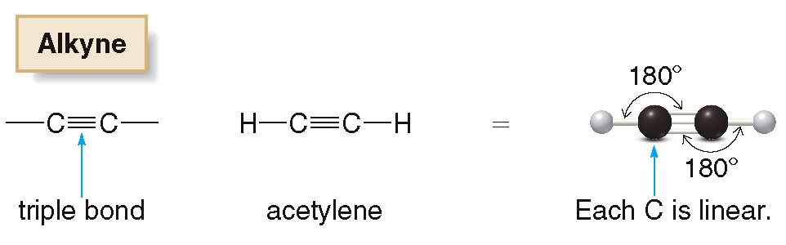
13.1 Alkenes and Alkynes (2)
Alkynes are compounds that contain a carbon−carbon triple bond.
Alkynes have the general formula C_{n}H_{2n − 2}.

Slide 4
13.1 Alkenes and Alkynes (3)
Alkenes and alkynes are composed of nonpolar bonds.
Their physical properties are like those of alkanes.
Alkenes and alkynes have low melting and boiling points and are insoluble in water.
They are called unsaturated hydrocarbons because they contain fewer than the maximum number of H atoms per C.

Slide 5
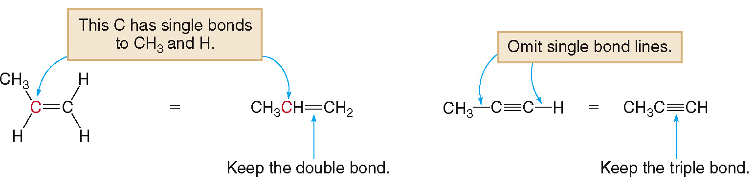
13.1 Alkenes and Alkynes (4)
The multiple bond is always drawn in a condensed structure.

Slide 6
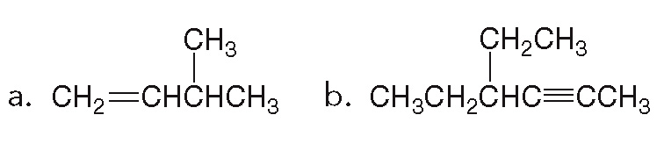
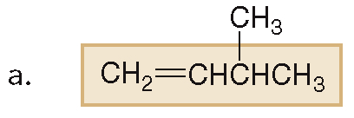
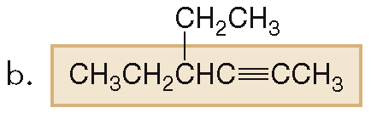
13.2 Nomenclature of Alkenes and Alkynes (1)
HOW TO Name an Alkene or Alkyne
Give the IUPAC name of each alkene and alkyne.
Example
Step [1]
Find the longest chain that contains both C atoms of the double or triple bond.

Slide 7
13.2 Nomenclature of Alkenes and Alkynes (2)
HOW TO Name an Alkene or Alkyne
Since the compound is an alkene, change the −ane ending to −ene.
4 C’s in longest chain butane to butene
Since the compound is an alkyne, change the −ane ending to −yne.
6 C’s in longest chain hexane to hexyne

Slide 8
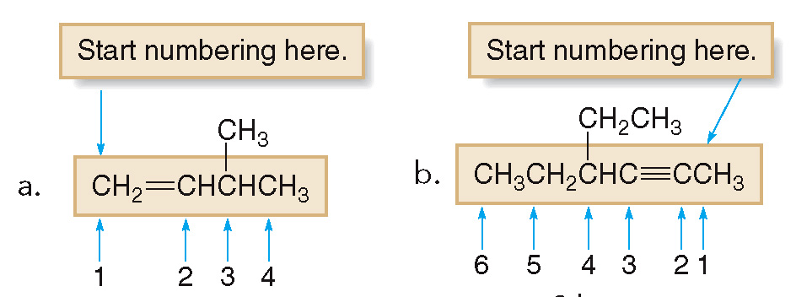
13.2 Nomenclature of Alkenes and Alkynes (3)
HOW TO Name an Alkene or Alkyne
Number the carbon chain from the end that gives the multiple bond the lower number.
Step [2]
1-butene
2-hexyne
Name the compound using the first number assigned to the multiple bond.

Slide 9
13.2 Nomenclature of Alkenes and Alkynes (4)
HOW TO Name an Alkene or Alkyne
Step [3]
Number and name the substituents, and write the name.

Slide 10
13.2 Nomenclature of Alkenes and Alkynes (5)
HOW TO Name an Alkene or Alkyne
Step [3]
Number and name the substituents, and write the name.

Slide 11
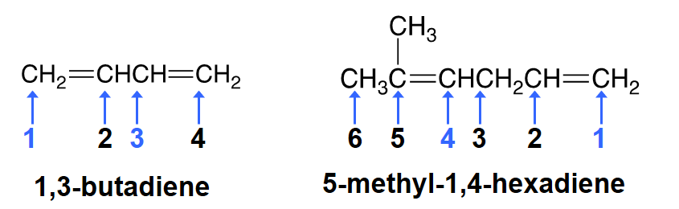
13.2 Nomenclature of Alkenes and Alkynes (6)
Compounds with two double bonds are called dienes.
Dienes are named by changing the −ane ending of the parent alkane to −adiene.
Each double bond gets its own number.

Slide 12
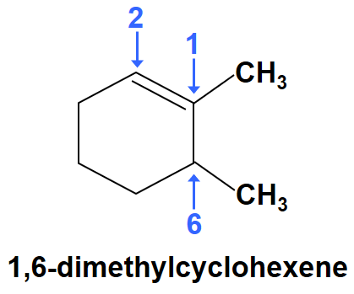
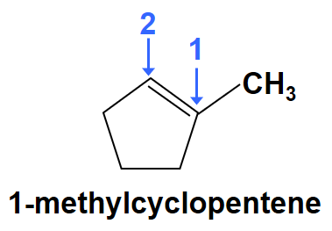
13.2 Nomenclature of Alkenes and Alkynes (7)
When naming cycloalkenes, the double bond is located between C1 and C2.
The “1” is usually omitted in the name.
The ring is numbered to give the first substituent the lower number.

Slide 13
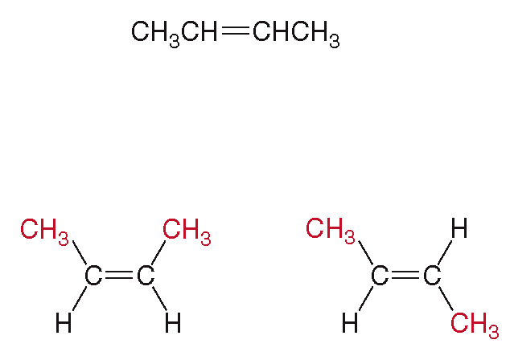
13.3 Cis–Trans Isomers (1)
A. Stereoisomers—A New Class of Isomer
There is restricted rotation around the C atoms of a double bond.
2-butene
Therefore, 2-butene has two possible arrangements:
two CH₃ groups on the same side cis isomer
two CH₃ groups on opposite sides trans isomer

Slide 14
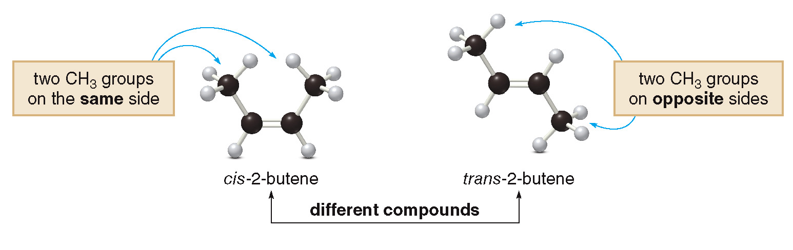
13.3 Cis–Trans Isomers (2)
A. Stereoisomers—A New Class of Isomer

Slide 15

13.3 Cis–Trans Isomers (3)
Stereoisomers—A New Class of Isomer
Whenever the two groups on each end of a C═C are different from each other, two isomers are possible.

Slide 16
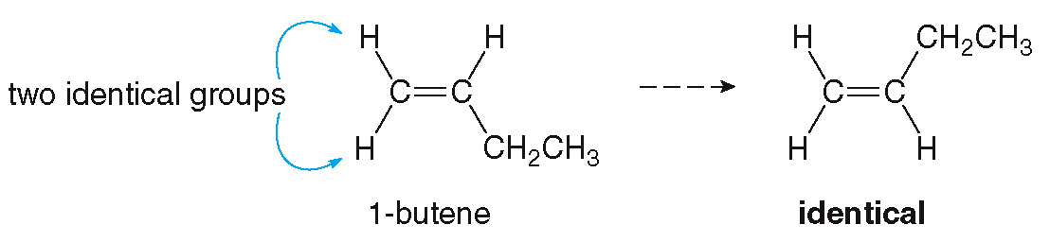
13.3 Cis–Trans Isomers (4)
Stereoisomers—A New Class of Isomer
When the two groups on one end of the double bond are identical (for example, both H or both CH₃), no cis and trans isomers are possible.

Slide 17
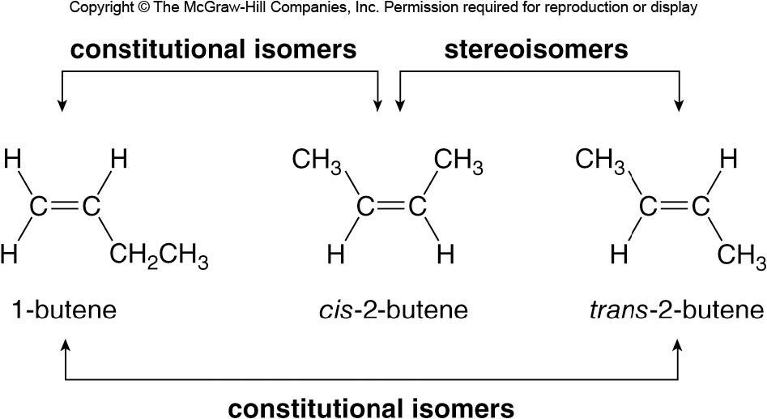
13.3 Cis–Trans Isomers (5)
A. Stereoisomers—A New Class of Isomer
Stereoisomers are isomers that differ only in the 3-D arrangement of atoms.
Constitutional isomers differ in the way the atoms are bonded to each other.

Slide 18
13.3 Cis–Trans Isomers (6)
Saturated and Unsaturated Fatty Acids
Fatty acids are carboxylic acids (RCOOH) with long carbon chains of 12 to 20 carbon atoms.
Naturally occurring animal fats and vegetable oils are formed from fatty acids.
Saturated fatty acids have no double bonds in their long hydrocarbon chains.
Unsaturated fatty acids have one or more double bonds in their long hydrocarbon chains.

Slide 19
13.3 Cis–Trans Isomers (7)
Saturated and Unsaturated Fatty Acids
Generally, double bonds in naturally occurring fatty acids are cis.
As the number of double bonds in the fatty acid increases, the melting point decreases.
Fats are generally formed from fatty acids having few double bonds; they are solids at room temp.
Oils are generally formed from fatty acids having a larger number of double bonds; they are liquid at room temp.

Slide 20
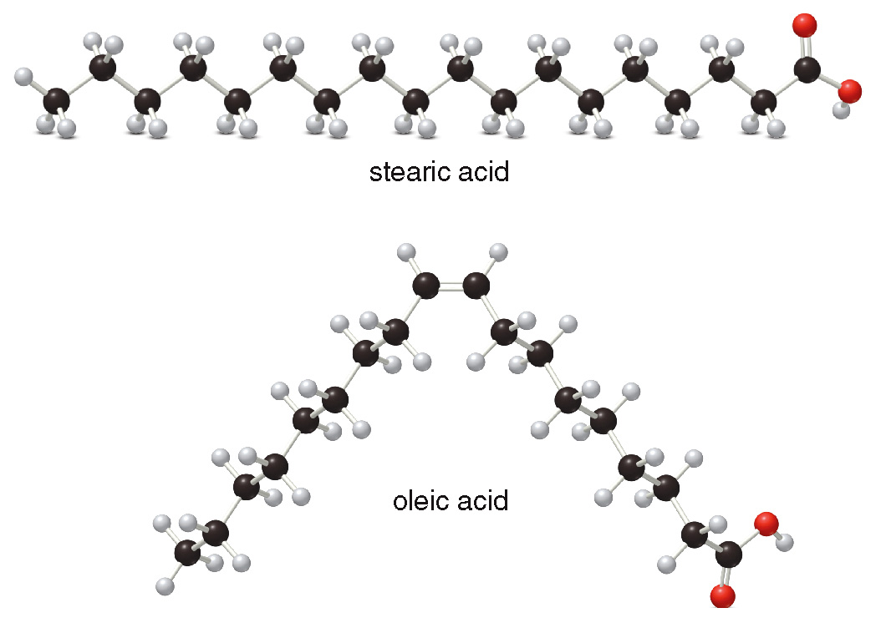
13.3 Cis–Trans Isomers (8)
B. Saturated and Unsaturated Fatty Acids

Slide 21
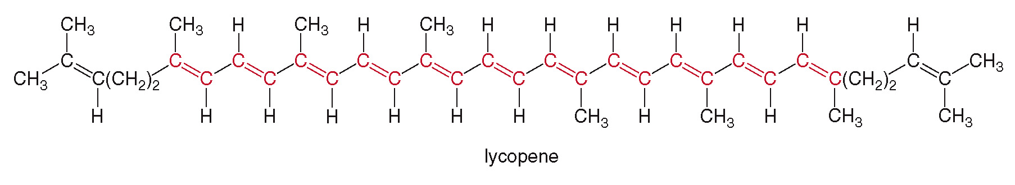
13.4 Interesting Alkenes in Food and Medicine (1)
Lycopene, the red pigment in tomatoes and watermelons, has 13 double bonds.
Lycopene is an antioxidant, a compound that prevents unwanted oxidation from occurring.
Diets containing high levels of antioxidants result in decreased risk of heart disease and cancer.

Slide 22
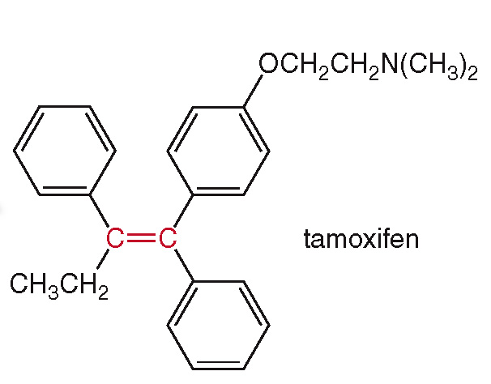
13.4 Interesting Alkenes in Food and Medicine (2)
Tamoxifen is used in the treatment of breast cancers that require estrogen for growth.

Slide 23
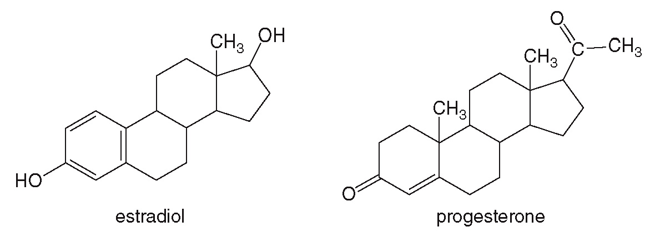
13.5 Focus on Health and Medicine Oral Contraceptives (1)
Synthetic birth control pills are similar in structure to the female sex hormones estradiol and progesterone, but they also contain a C–C triple bond.

Slide 24
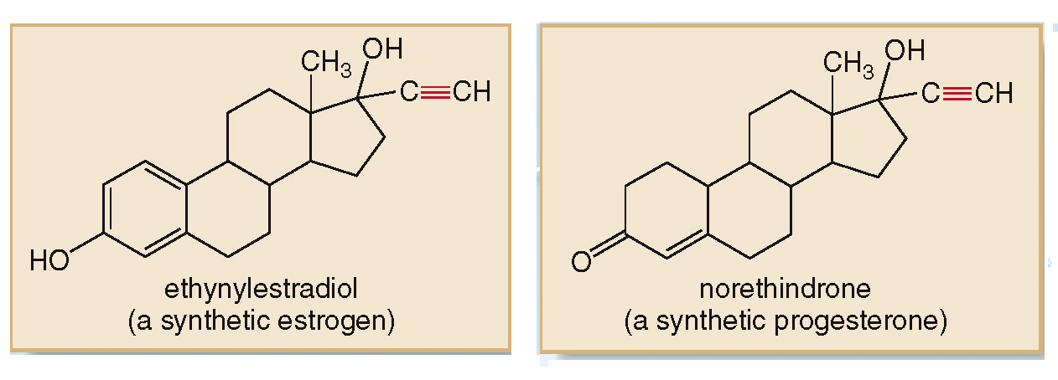
13.5 Focus on Health and Medicine Oral Contraceptives (2)
The two most commonly used birth control drugs are ethynylestradiol and norethindrone.

Slide 25
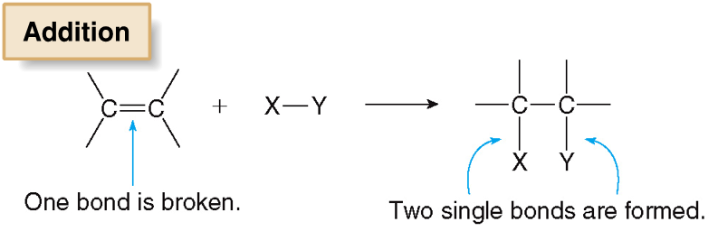
13.6 Reactions of Alkenes (1)
Alkenes undergo addition reactions wherein new groups X and Y are added to the alkene.
One bond of the double bond is broken and two new single bonds are formed.

Slide 26
13.6 Reactions of Alkenes (2)

Slide 27
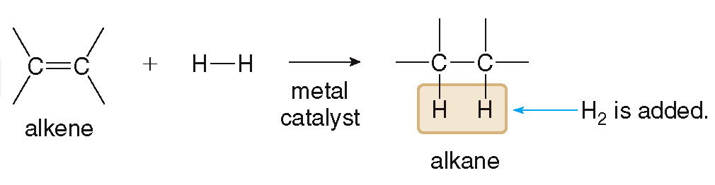
13.6 Reactions of Alkenes (3)
Addition of Hydrogen—Hydrogenation
Hydrogenation is the addition of H₂ to an alkene.
The metal catalyst (usually palladium—Pd) speeds up the rate of the reaction.
The product of hydrogenation is an alkane.

Slide 28
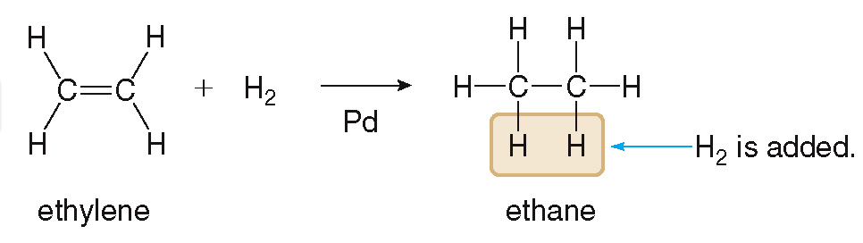
13.6 Reactions of Alkenes (4)
Addition of Hydrogen—Hydrogenation
The metal catalyst provides a surface that binds both the alkene and H₂, which speeds up the rate of reaction.

Slide 29
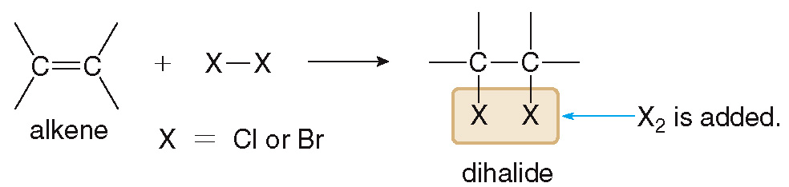
13.6 Reactions of Alkenes (5)
Addition of Halogen—Halogenation
Halogenation is the addition of halogen (X₂) to an alkene.
X₂ is usually Cl₂ or Br₂.
Halogenation occurs readily and does not require a catalyst.
The product of halogenation is a dihalide.

Slide 30
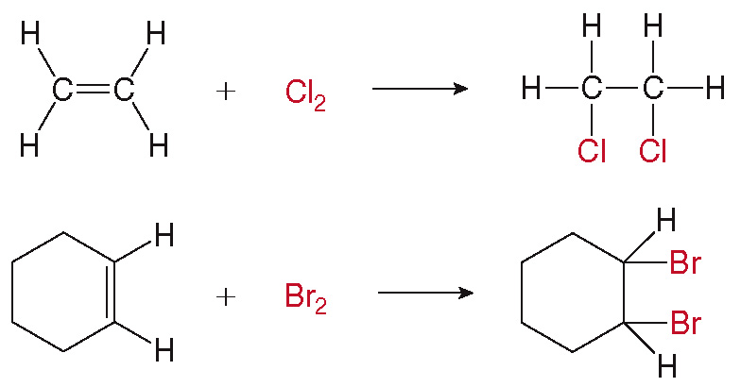
13.6 Reactions of Alkenes (6)
B. Addition of Halogen—Halogenation

Slide 31
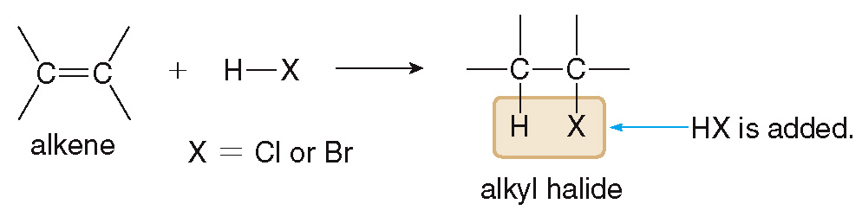
13.6 Reactions of Alkenes (7)
C. Addition of Hydrogen Halides— Hydrohalogenation
Hydrohalogenation is the addition of HX (HCl or HBr) to an alkene.
The product of hydrohalogenation is an alkyl halide.

Slide 32
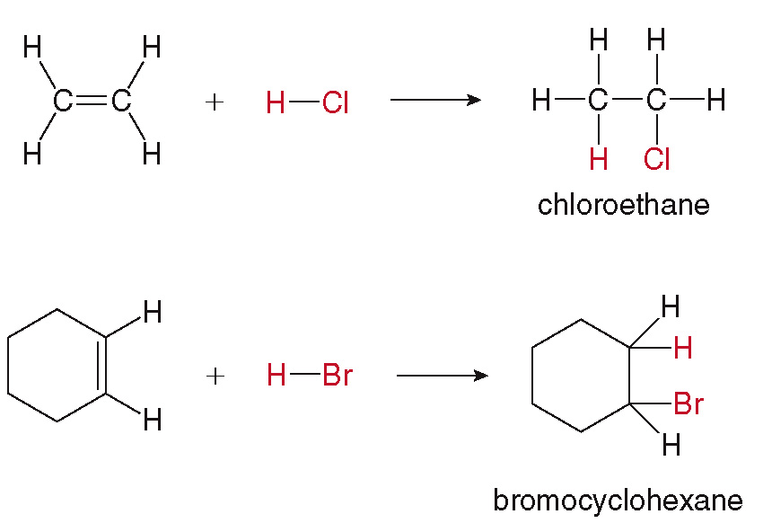
13.6 Reactions of Alkenes (8)
C. Addition of Hydrogen Halides— Hydrohalogenation

Slide 33
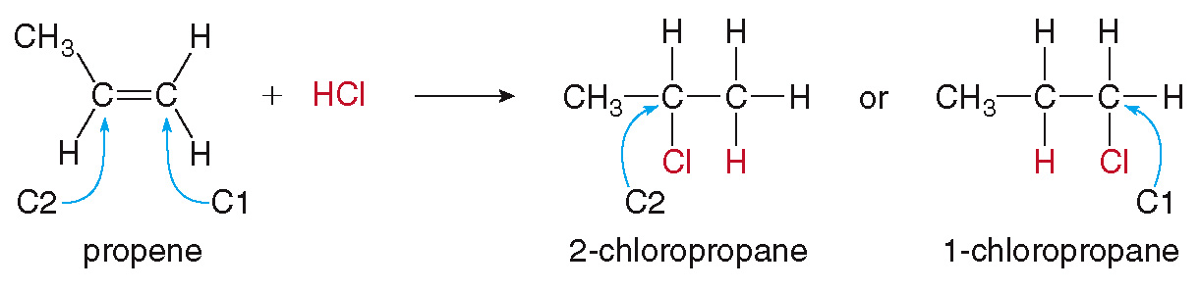
13.6 Reactions of Alkenes (9)
Addition of Hydrogen Halides— Hydrohalogenation
If the reactant is an asymmetrical alkene, two possible products can be formed in theory.
These two potential products are constitutional isomers.

Slide 34
13.6 Reactions of Alkenes (10)
Addition of Hydrogen Halides— Hydrohalogenation
  To determine which of the two products will actually form, we use Markovnikov’s rule.
  Markovnikov’s rule states that the H atom of H–X will bond to the less substituted C atom in the C=C double bond.
  This means the C in the double bond with the most H’s will bond to the H atom of H–X.

Slide 35
13.6 Reactions of Alkenes (11)
Addition of Hydrogen Halides— Hydrohalogenation

Slide 36
13.6 Reactions of Alkenes (12)
Addition of Hydrogen Halides— Hydrohalogenation

Slide 37
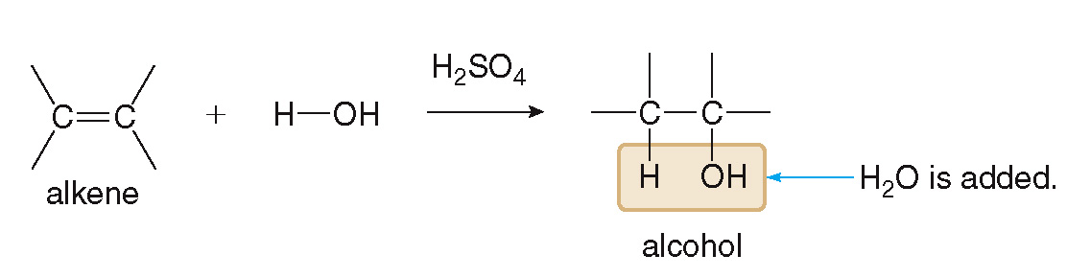
13.6 Reactions of Alkenes (13)
Addition of Water—Hydration
Hydration is the addition of water to an alkene.
Hydration requires a strong acid, H₂SO₄.
The product formed by hydration is an alcohol.

Slide 38
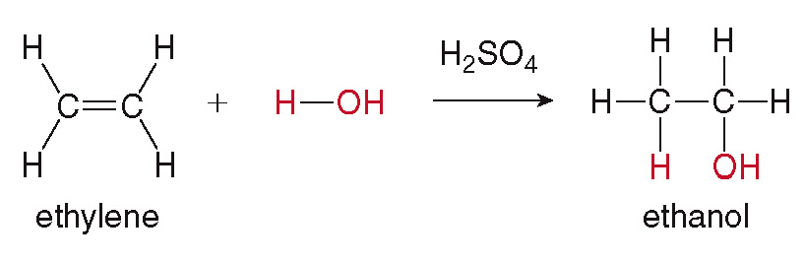
13.6 Reactions of Alkenes (14)
Addition of Water—Hydration

Slide 39
13.6 Reactions of Alkenes (15)
Addition of Water—Hydration
If the reactant is an asymmetrical alkene, the product will be determined by Markovnikov’s rule.

Slide 40
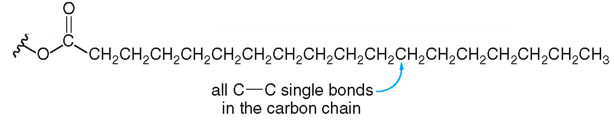
13.7 Focus on Health and Medicine Margarine or Butter? (1)
Butter is made up of saturated fatty acid chains.
A diet rich in saturated fatty acids is widely considered to be unhealthy.
Scientists have attempted to produce alternative versions of butter (margarine) with similar taste and properties, but with some C═C double bonds (that is, unsaturated fatty acid chains).

Slide 41
13.7 Focus on Health and Medicine Margarine or Butter? (2)
Most naturally occurring unsaturated fatty acid compounds are liquids at room temperature.
To make the desired butter alternative, we need a compound that is a solid at room temperature.
This is done by partially hydrogenating unsaturated fatty acid compounds.
This process allows only a few C═C double bonds to remain on the chain, making a solid fatty acid that is not naturally occurring.

Slide 42
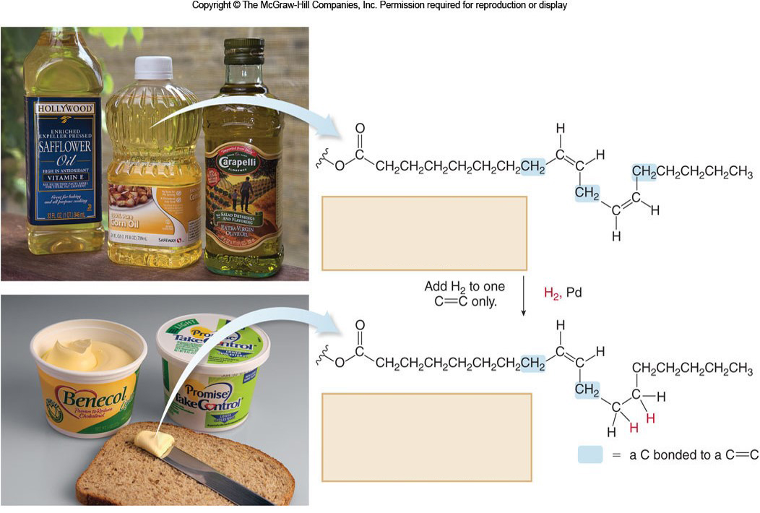
13.7 Focus on Health and Medicine Margarine or Butter? (3)
Unsaturated vegetable oil
two C=C’s
lower melting
liquid at room temperature
Partially hydrogenated oil
in margarine
one C=C
higher melting
semi-solid at room temperature
© The McGraw-Hill Companies, Inc./Jill Braaten, photographer

Slide 43
13.7 Focus on Health and Medicine Margarine or Butter? (4)
Some partial hydrogenations leave trans double bonds on the fatty acid chain.
Trans fatty acids are very similar in shape to saturated fatty acids.
Trans fatty acids are widely considered to be just as unhealthy as saturated fatty acids.
Nutritionists agree that a healthy diet consists of very few saturated or trans fats.

Slide 44
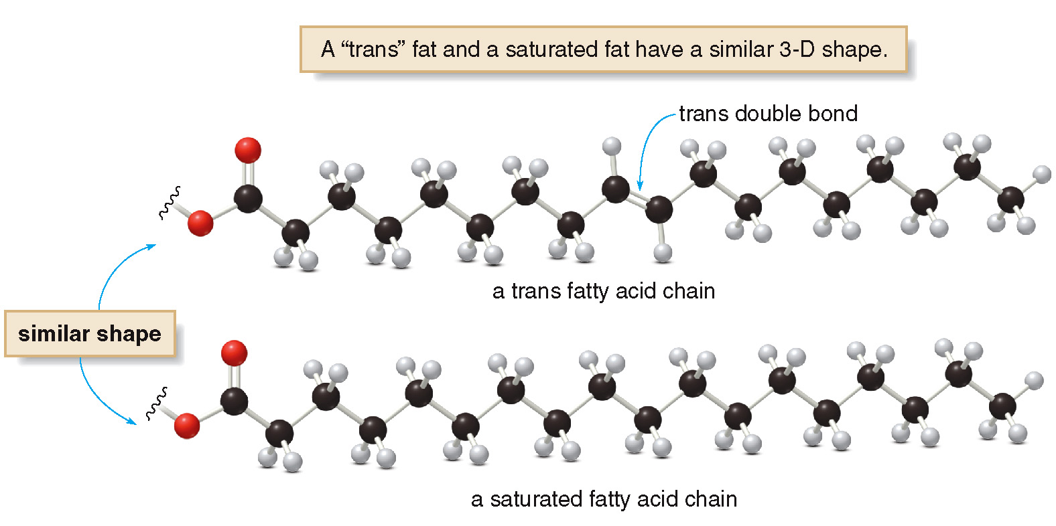
13.7 Focus on Health and Medicine Margarine or Butter? (5)

Slide 45
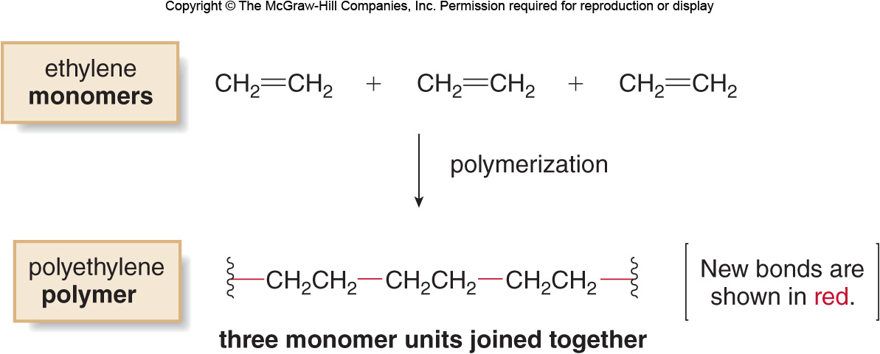
13.8 Polymers (1)
Polymers are large molecules made up of repeating units of smaller molecules (monomers) covalently bonded together.

Slide 46
13.8 Polymers (2)
Synthetic Polymers
In polymerization, the monomer C═C double bonds are broken and single bonds linking the monomers together are formed.

Slide 47
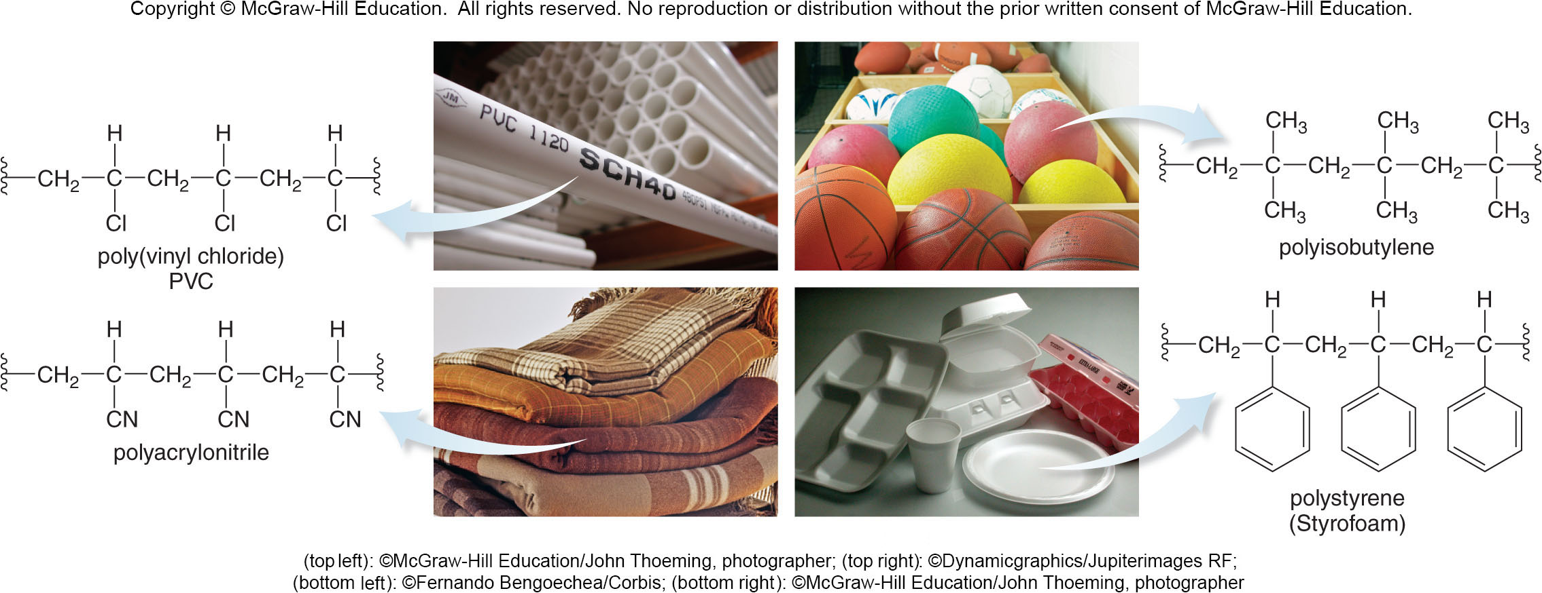
13.8 Polymers (3)
Synthetic Polymers
(top left): ©McGraw-Hill Education/John Thoeming, photographer; (top right): ©Dynamicgraphics/Jupiterimages RF;
(bottom left): ©Fernando Bengoechea/Corbis; (bottom right): © McGraw-Hill Education/John Thoeming, photographer

Slide 48
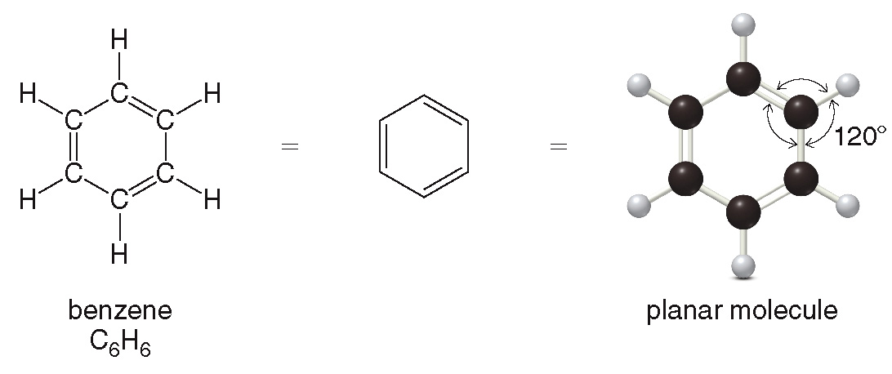
13.9 Aromatic Compounds (1)
Aromatic compounds are compounds that contain a benzene ring.
Each C is trigonal planar (that is,
bond
angles), making benzene a planar molecule.

Slide 49
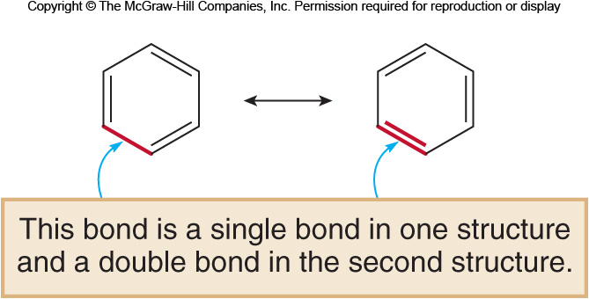
13.9 Aromatic Compounds (2)
Each of these representations has the same arrangement of atoms, but different locations of electrons.
These are resonance structures, and neither is the true structure of benzene.
The actual structure is a combination of both resonance structures, called a hybrid.

Slide 50
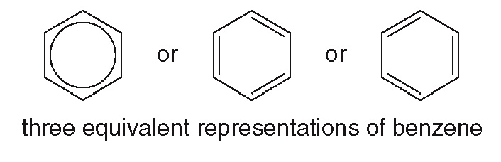
13.9 Aromatic Compounds (3)
In this hybrid structure, all three electron pairs in the double bonds are delocalized in the six-membered ring.
This can be drawn as a circle inside the hexagon.
Delocalization gives benzene added stability compared to other unsaturated hydrocarbons.

Slide 51
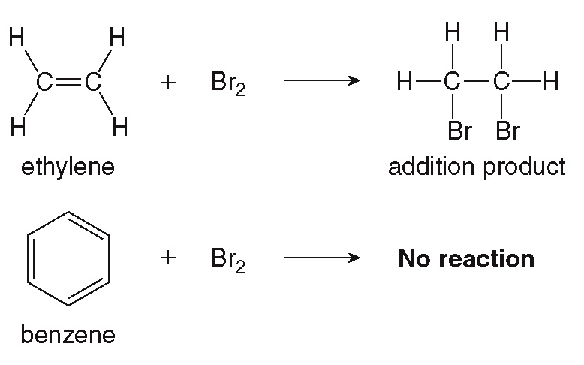
13.9 Aromatic Compounds (4)
Aromatic hydrocarbons do not undergo the addition reactions that characterize alkenes.

Slide 52
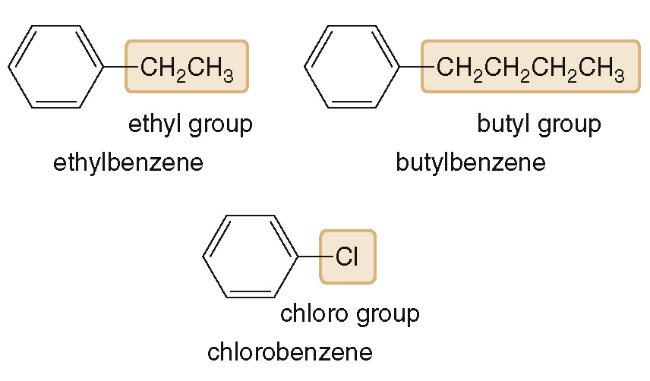
13.10 Nomenclature of Benzene Derivatives (1)
Monosubstituted Benzenes
To name a benzene ring with one substituent:
Name the substituent first
Then add the word benzene at the end

Slide 53
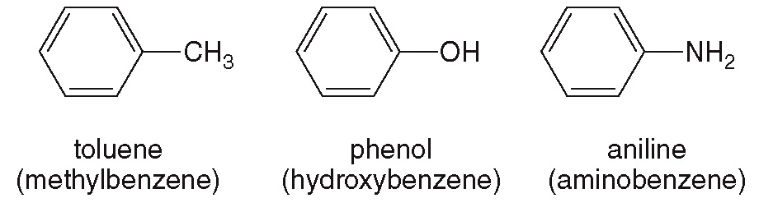
13.10 Nomenclature of Benzene Derivatives (2)
Monosubstituted Benzenes
Some monosubstituted benzenes have common names.

Slide 54
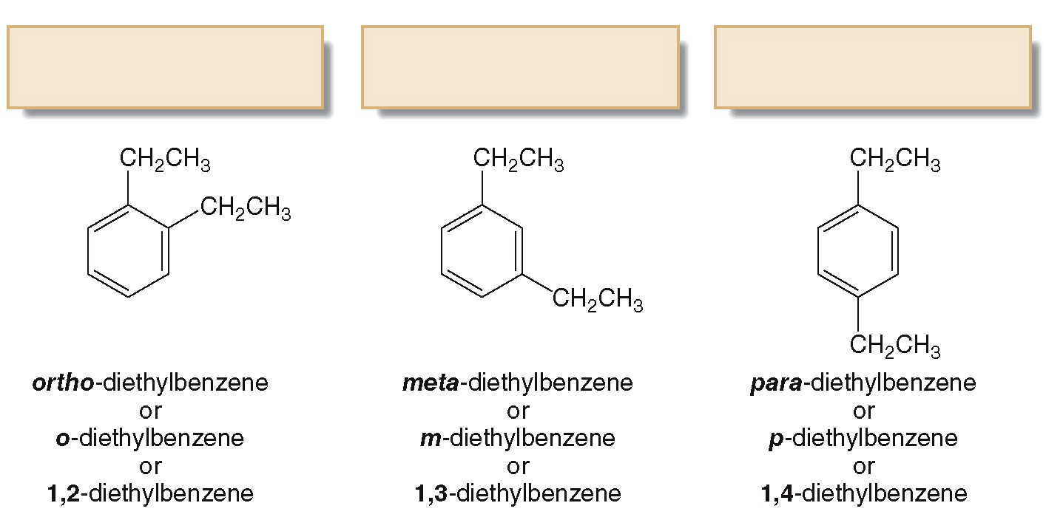
13.10 Nomenclature of Benzene Derivatives (3)
Disubstituted Benzenes
1,2-Disubstituted benzene ortho isomer
1,3-Disubstituted benzene meta isomer
1,4-Disubstituted benzene para isomer

Slide 55
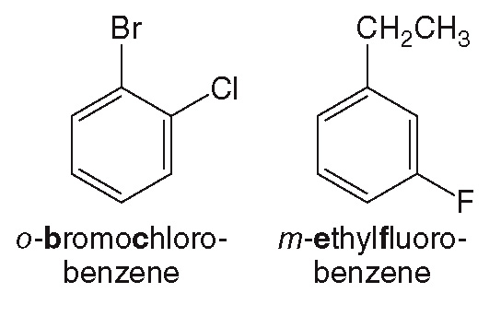
13.10 Nomenclature of Benzene Derivatives (4)
Disubstituted Benzenes
If there are two groups on the benzene ring and they are different, alphabetize the two substituent names.

Slide 56
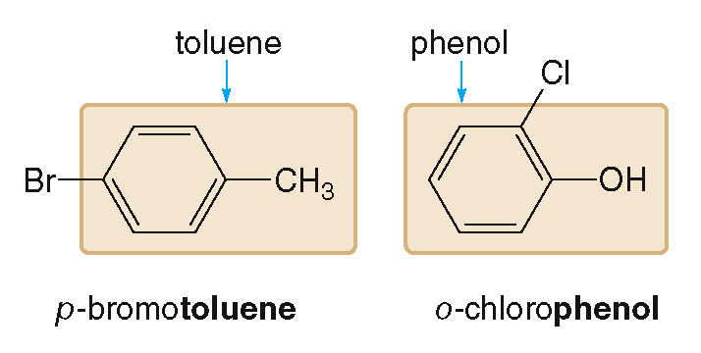
13.10 Nomenclature of Benzene Derivatives (5)
Disubstituted Benzenes
If one of the two substituents is part of a common root, then name the molecule as a derivative of that monosubstituted benzene.

Slide 57
13.10 Nomenclature of Benzene Derivatives (6)
Polysubstituted Benzenes
Number to give the lowest possible numbers around the ring.
Alphabetize the substituent names.
When the substituents are part of common roots:
Name the molecule as a derivative of that monosubstituted benzene
Put the common root substituent at C1, but omit the “1” from the name

Slide 58
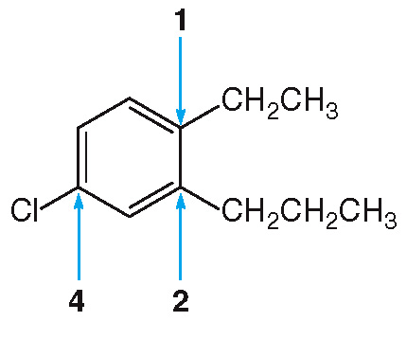
13.10 Nomenclature of Benzene Derivatives (7)
Polysubstituted Benzenes
Assign the lowest set of numbers.
Alphabetize the names of all the substituents.
4-chloro-1-ethyl-2-propylbenzene

Slide 59
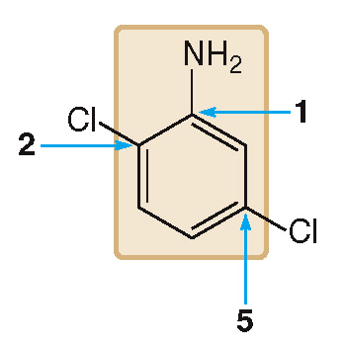
13.10 Nomenclature of Benzene Derivatives (8)
Polysubstituted Benzenes
Name the molecule as a derivative of the common root aniline.
Assign the NH₂ group to position 1 and then assign the lowest possible set of numbers to the other groups.
2,5-dichloroaniline

Slide 60
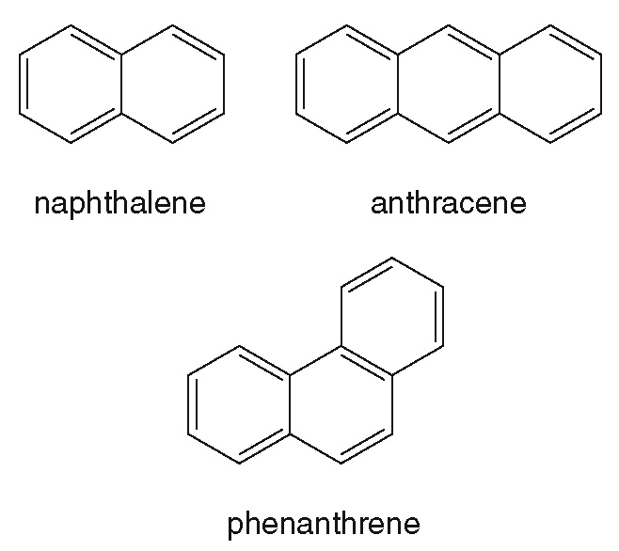
13.10 Nomenclature of Benzene Derivatives (9)
Aromatic Compounds with More than One Ring

Slide 61
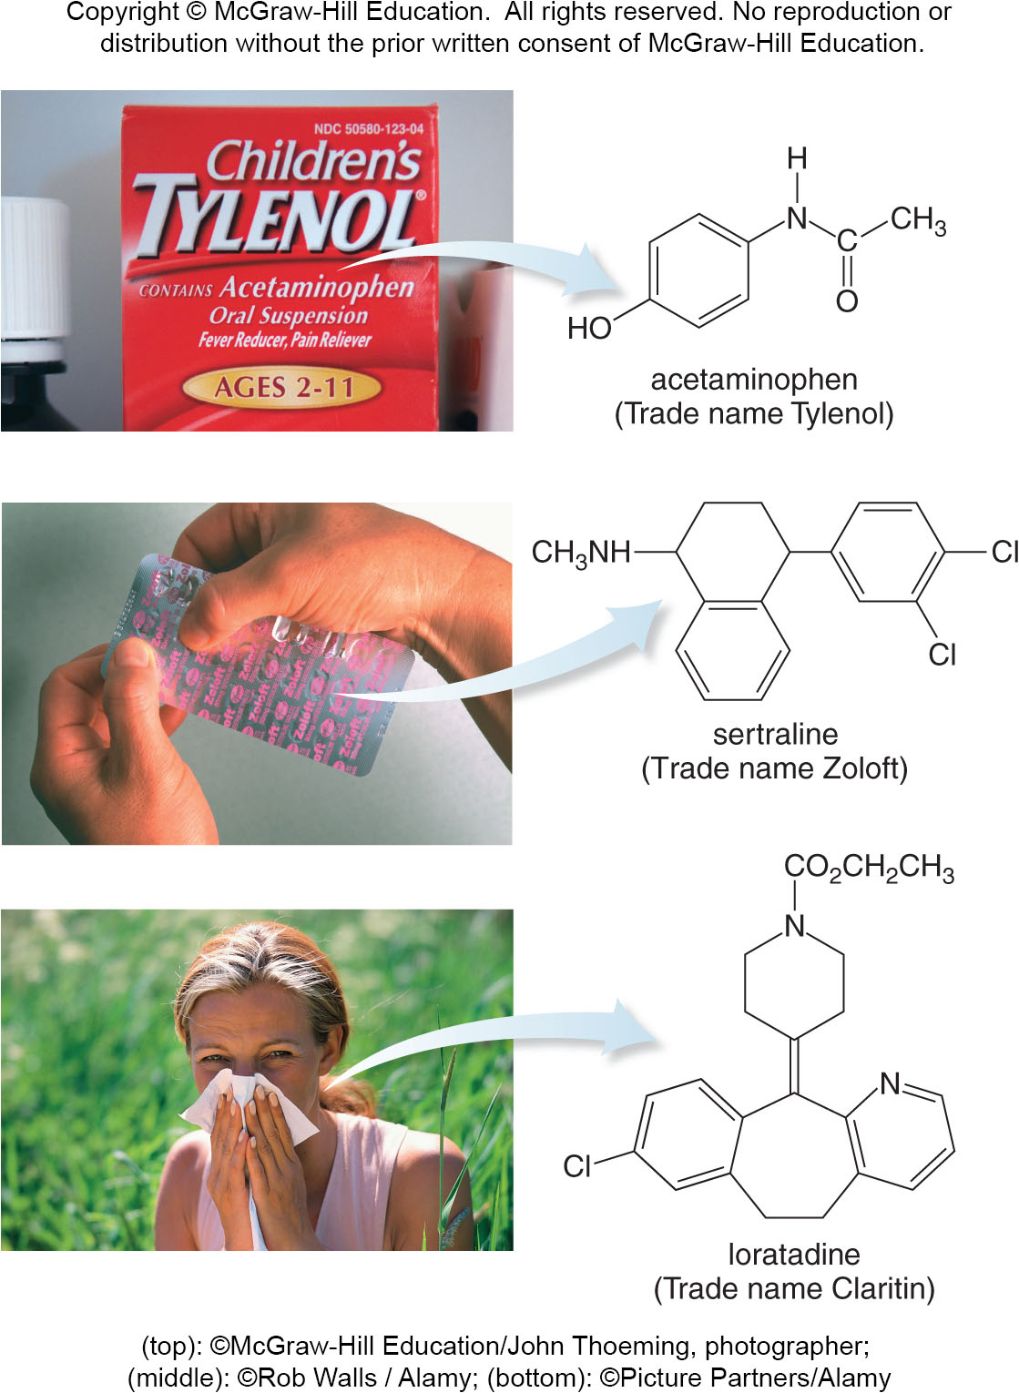
13.11 Focus on Health and Medicine
Aromatic Drugs, Sunscreens, and Carcinogens (1)
Some common drugs that contain benzene rings are:
(top): ©McGraw-Hill Education/John Thoeming, photographer; (middle): ©Rob Walls/ Alamy; (bottom): ©Picture Partners/Alamy

Slide 62
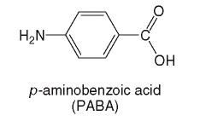
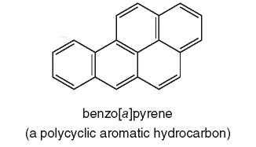
13.11 Focus on Health and Medicine
Aromatic Drugs, Sunscreens, and Carcinogens (2)
A common sunscreen used contains benzene:
A common environmental pollutant that is a potential carcinogen has several benzene rings:

Slide 63

13.13 Reactions of Aromatic Compounds (1)
Aromatic compounds undergo substitution reactions primarily.
Substitution is a reaction in which an atom is replaced by another atom or group of atoms.
Substitution of H by X keeps the stable aromatic ring intact.

Slide 64


13.13 Reactions of Aromatic Compounds (2)
Chlorination and DDT
In chlorination, a Cl atom substitutes for a hydrogen atom on the benzene ring.
The pesticide DDT is formed by a chlorination reaction.

Slide 65

13.13 Reactions of Aromatic Compounds (3)
Nitration and Sulfa Drugs
Benzene reacts with nitric acid (HNO₃) in the presence of sulfuric acid (H₂SO₄) to form nitrobenzene.
Substitution of a nitro group (NO₂) for a hydrogen is called nitration.

Slide 66

13.13 Reactions of Aromatic Compounds (4)
Nitration and Sulfa Drugs
Sulfa drugs, such as the antibacterial agents shown below, are formed by the nitration reaction.

Slide 67


13.13 Reactions of Aromatic Compounds (5)
Sulfonation and Detergent Synthesis
In sulfonation, benzene reacts with SO₃ in the presence of H₂SO₄ such that a SO₃H group substitutes for a hydrogen atom on the benzene ring.
The synthetic detergent shown is a product of sulfonation.

