Slide 1

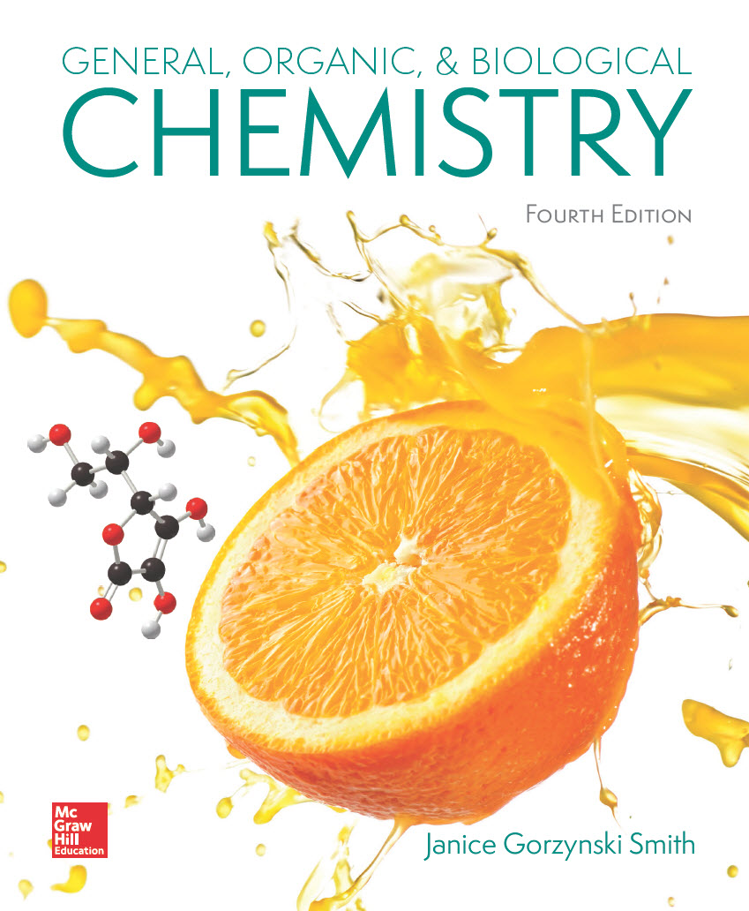
Chapter 21
Lecture Outline
Prepared by
Harpreet Malhotra
Florida State College at Jacksonville

Slide 2
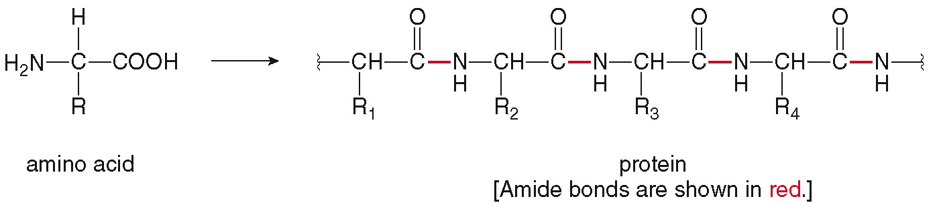
21.1 Introduction (1)
Proteins are biomolecules that contain many amide bonds, formed by joining amino acids.

Slide 3
21.1 Introduction (2)
Proteins account for 50% of the dry weight of the human body.
Unlike lipids and carbohydrates, proteins are not stored, so they must be consumed daily.
Current recommended daily intake for adults is 0.8 grams of protein per kg of body weight (more is needed for children).
Dietary protein comes from eating meat and milk.

Slide 4
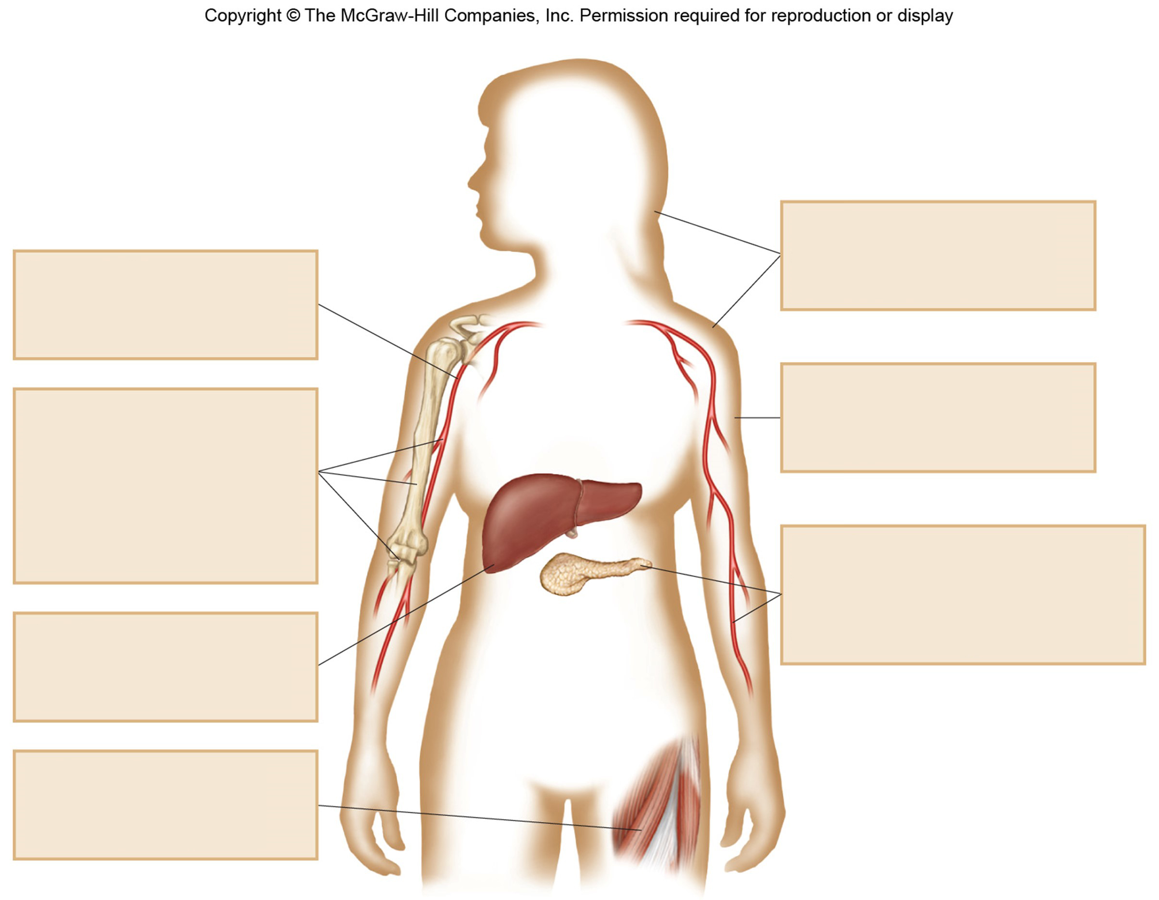
21.1 Introduction (3)
keratin
fibrous protein in hair, skin, and nails
hemoglobin
transport protein that carries O₂ in the blood
myoglobin
protein that stores O₂ in tissues
collagen
fibrous protein in connective tissue
found in tendons, bone, cartilage, and blood vessels
insulin
protein hormone synthesized in the pancreas
controls blood glucose levels
ferritin
protein that stores iron in the liver
actin and myosin
proteins that control muscle contractions

Slide 5
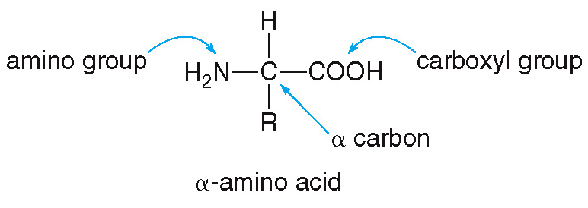
21.2 Amino Acids (1)
General Features of Amino Acids
Amino acids contain two functional groups—an amino group (NH₂) and a carboxyl group (COOH).
The amino group is attached to the
, the
C atom adjacent to the carbonyl group.

Slide 6
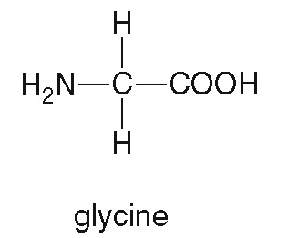
21.2 Amino Acids (2)
General Features of Amino Acids
The simplest amino acid is glycine, where R = H.
The R group, called the side chain, determines the identity of the amino acid.
If R = a basic N atom, it is a basic amino acid.
If R = an additional COOH group, it is an acidic amino acid.

Slide 7
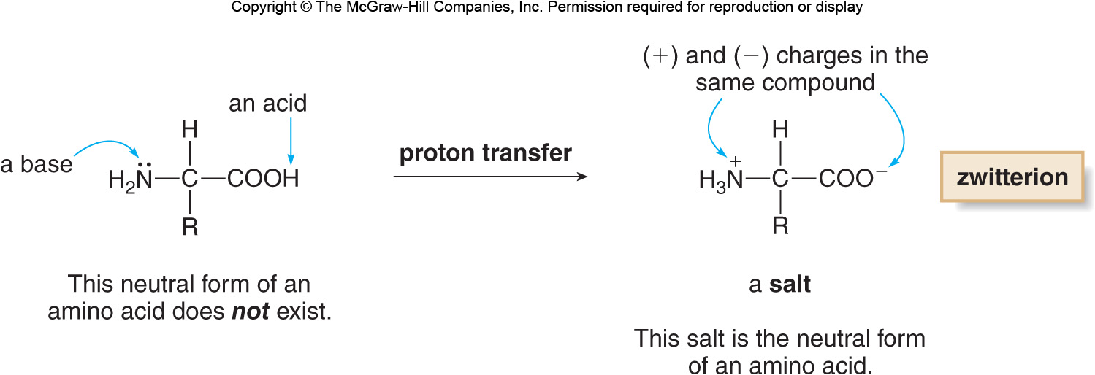
21.2 Amino Acids (3)
General Features of Amino Acids
Since amino acids contain a base (NH₂) and an acid (COOH), a proton transfers from the acid to the base to form a zwitterion.

Slide 8
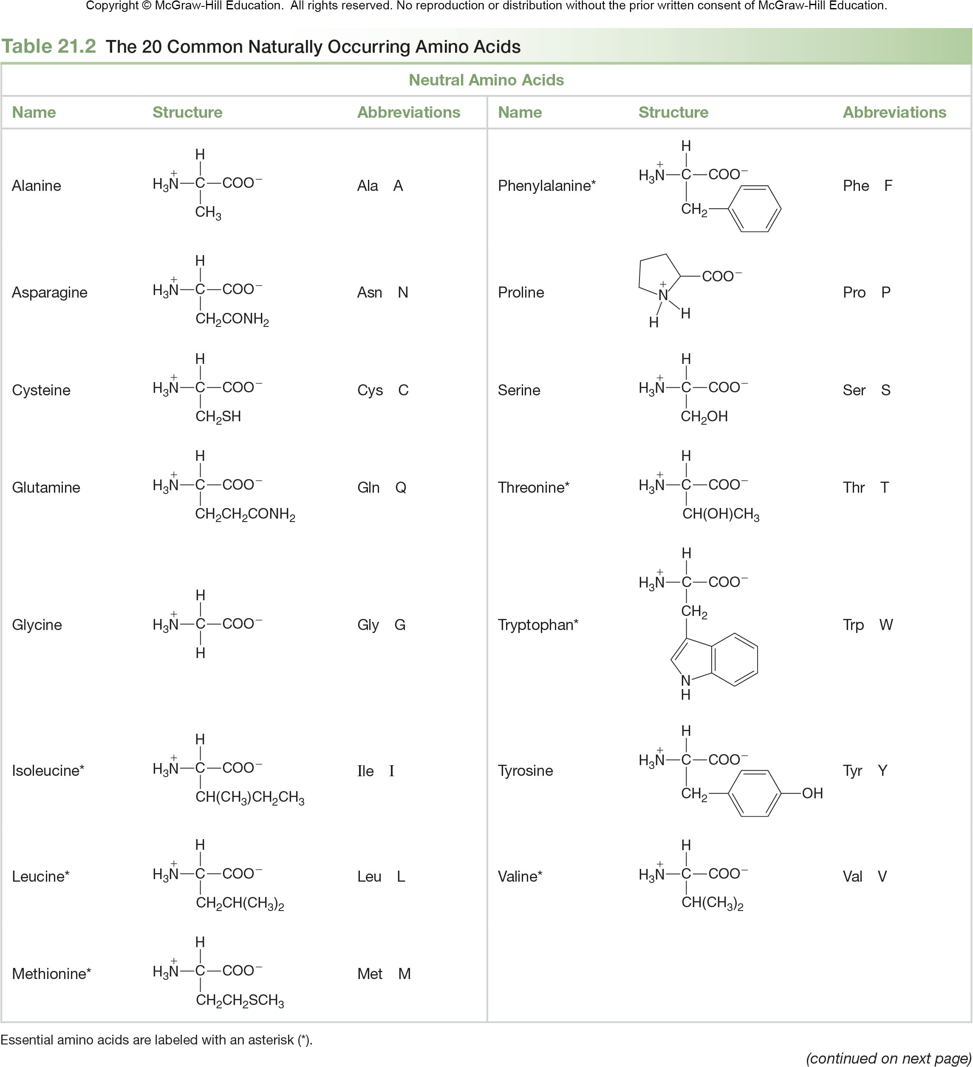
21.2 Amino Acids (4)
Table 21.2 The 20 Common Naturally Occurring Amino Acids
Neutral Amino Acids
Name
Structure
Abbreviations
Name
Structure
Abbreviations
Alanine
Ala A
Phenylalanine*
Phe F
Asparagine
Asn N
Proline
Pro P
Cysteine
Cys C
Serine
Ser S
Glutamine
Gln Q
Threonine*
Thr T
Glycine
Gly G
Tryptophan*
Trp W
Isoleucine*
Ile I
Tyrosine
Tyr Y
Leucine*
Leu L
Valine*
Val V
Methionine*
Met M
Essential amino acids are labeled with an asterisk (*).
(continued on next page)

Slide 9
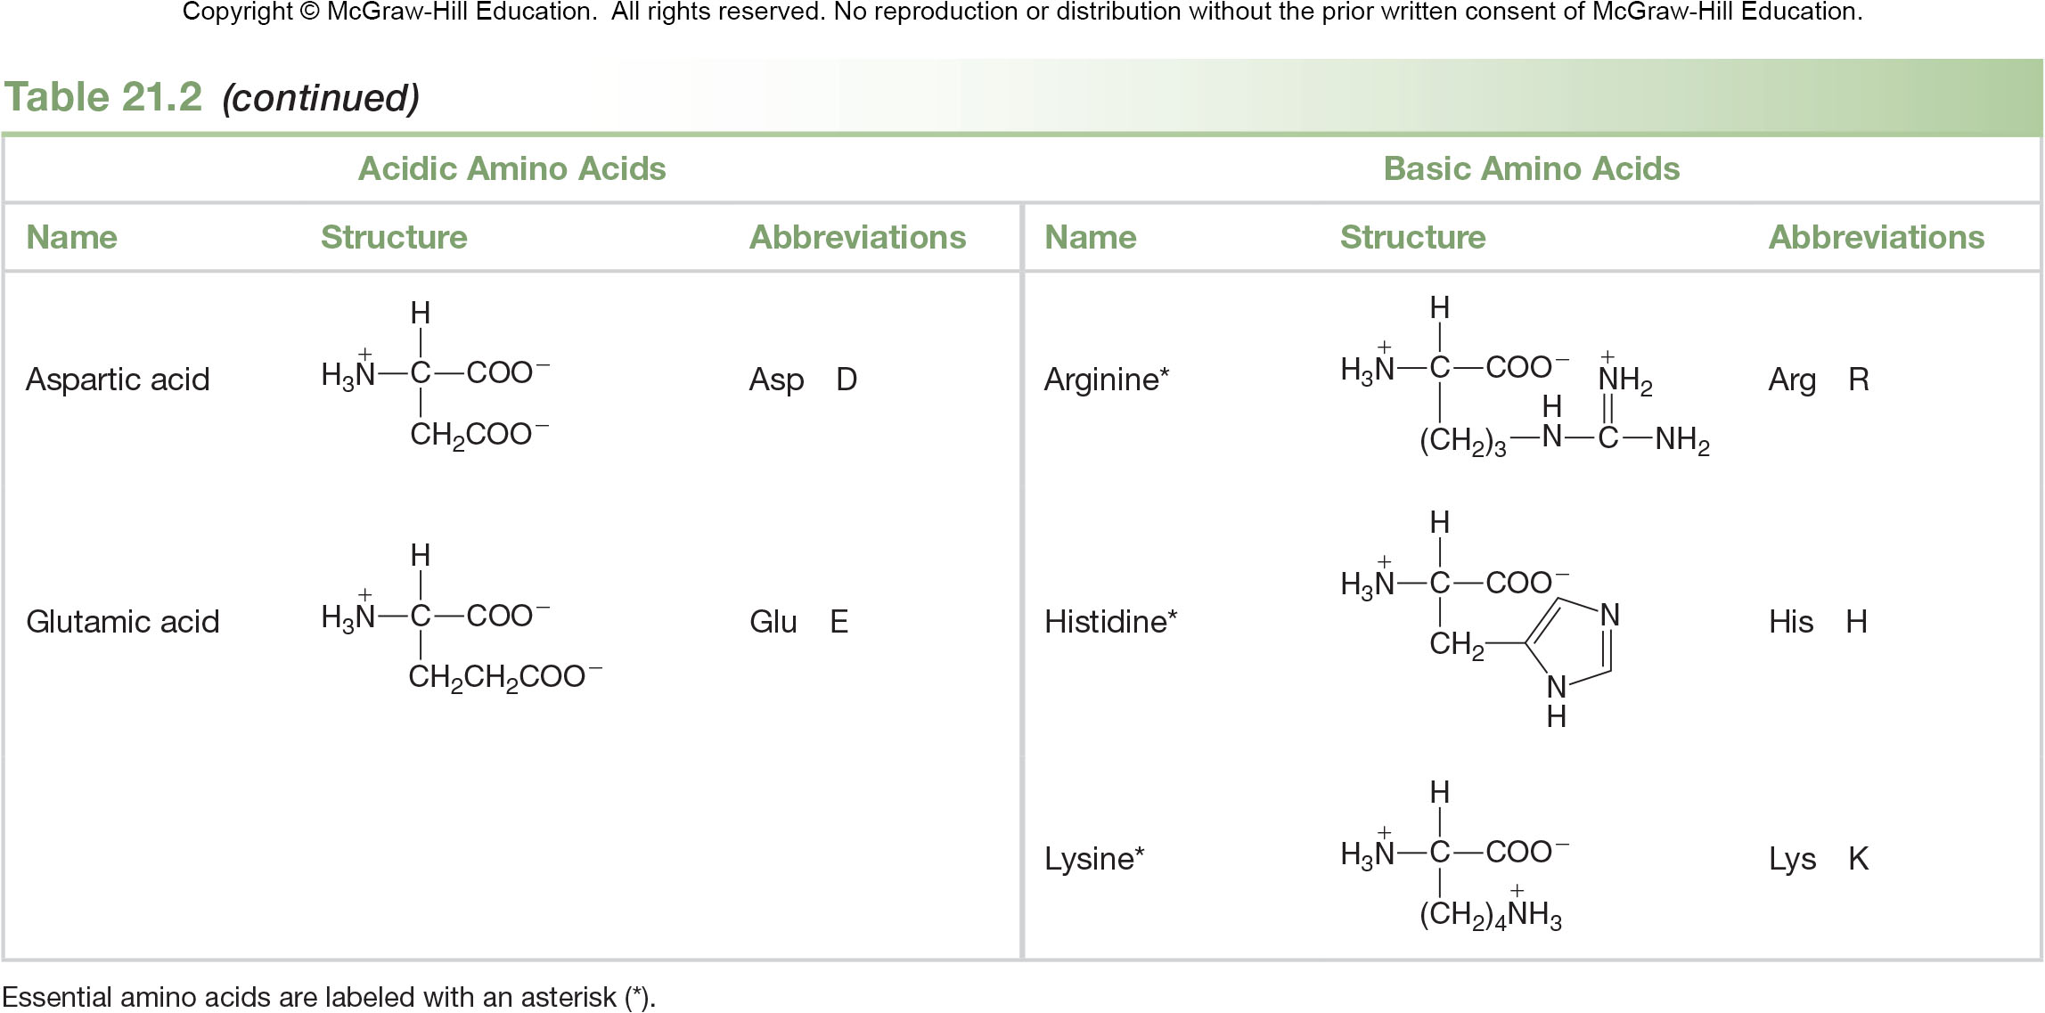
21.2 Amino Acids (5)
Table 21.2 The 20 Common Naturally Occurring Amino Acids
Acidic Amino Acids
Basic Amino Acids
Name
Structure
Abbreviations
Name
Structure
Abbreviations
Aspartic acid
Asp D
Arginine*
Arg R
Glutamic acid
Glu E
Histidine*
His H
Lysine*
Lys K
Essential amino acids are labeled with an asterisk (*).

Slide 10
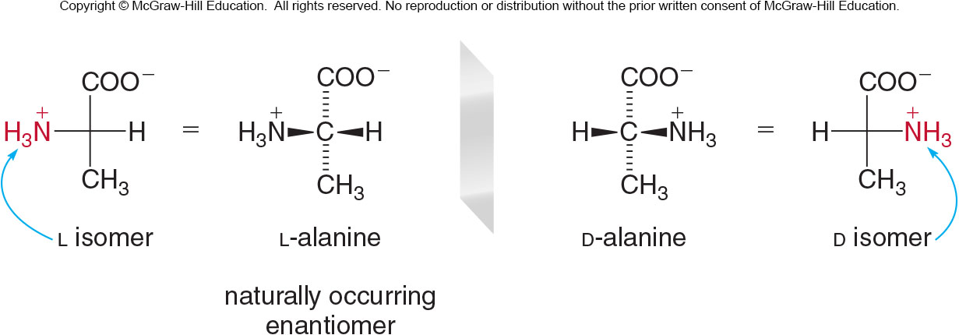
21.2 Amino Acids (6)
Stereochemistry of Amino Acids
All amino acids (save glycine) have a chirality center on the
carbon.
L amino acids have the
group on the left.
D amino acids have the
group on the right.

Slide 11
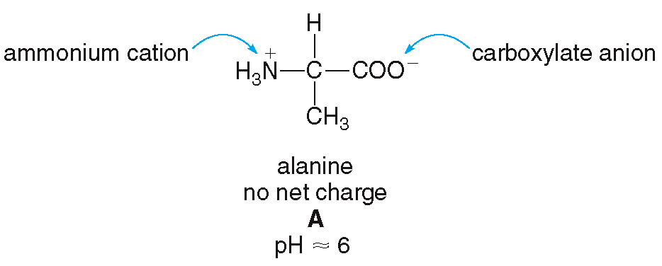
21.3 Acid-Base Behavior of Amino Acids (1)
An amino acid exists as a neutrally charged zwitterion at a certain pH, the isoelectric pH.
The amino acid can exist in different forms, depending on the pH of the aqueous environment.

Slide 12
21.3 Acid-Base Behavior of Amino Acids (2)
When the pH < isoelectric pH, the carboxylate anion gains a proton, and the amino acid has a net positive charge.
pH ≤ 2

Slide 13
21.3 Acid-Base Behavior of Amino Acids (3)
When the pH > isoelectric pH, the ammonium cation loses a proton, and the amino acid has a net negative charge.
pH ≥ 2

Slide 14
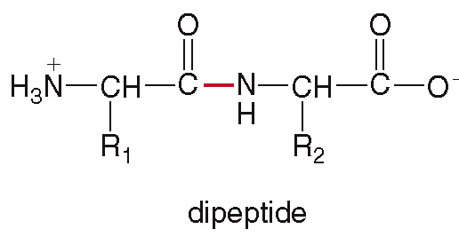
21.4 Peptides (1)
Peptides and proteins are formed when amino acids are joined together by amide bonds.
A dipeptide has two amino acids joined together by one amide bond.
The amide bond is called a peptide bond.

Slide 15
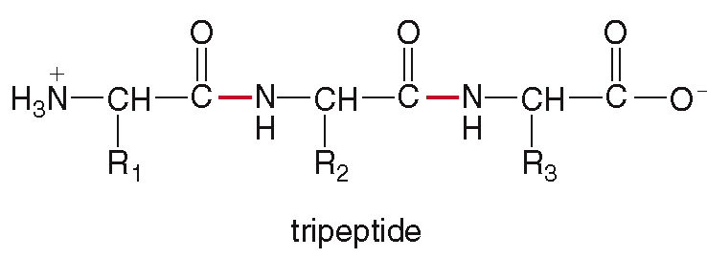
21.4 Peptides (2)
A tripeptide has three amino acids joined together by one amide bond.
Polypeptides have many amino acids, while proteins have more than 40 amino acids.

Slide 16
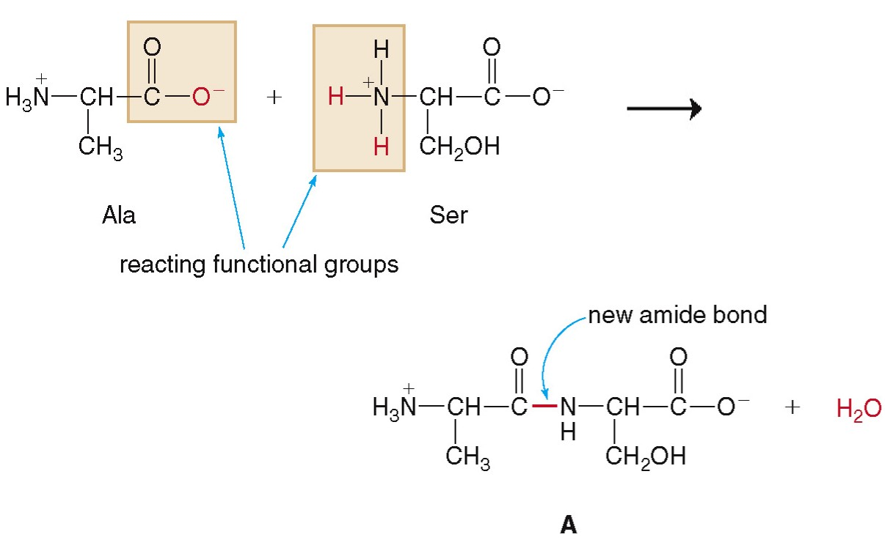
21.4 Peptides (3)
The amino acids Ala and Ser can combine in this way:

Slide 17
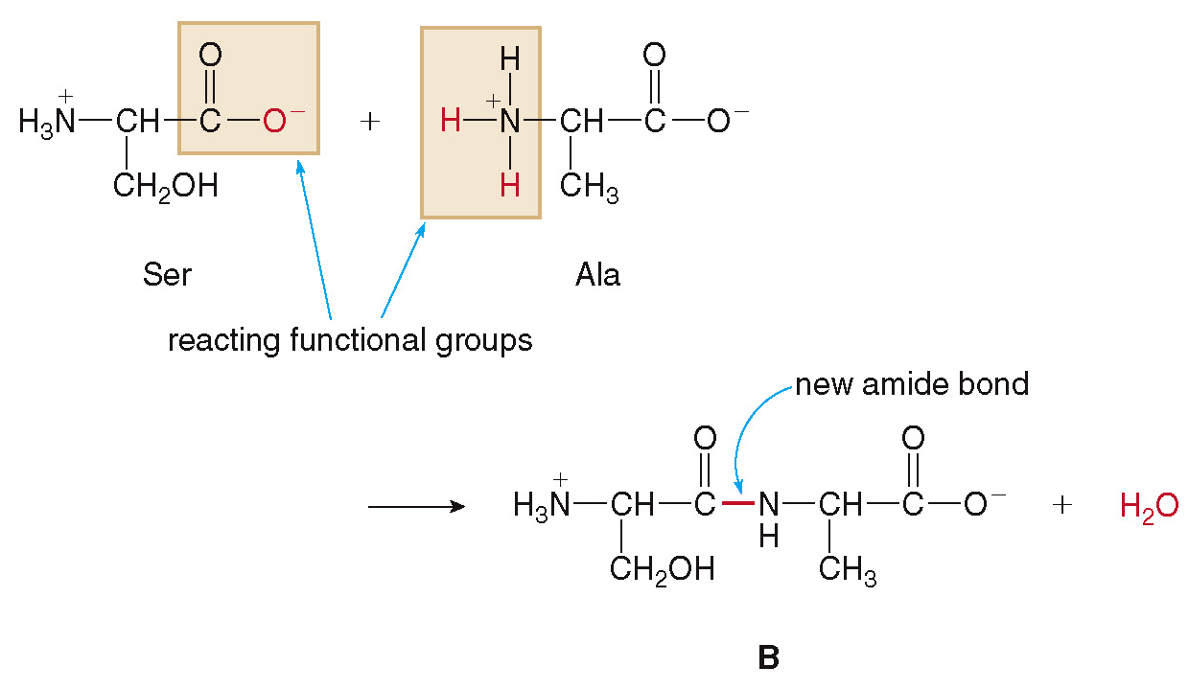
21.4 Peptides (4)
Or, the two can combine with Ser first and Ala second:

Slide 18
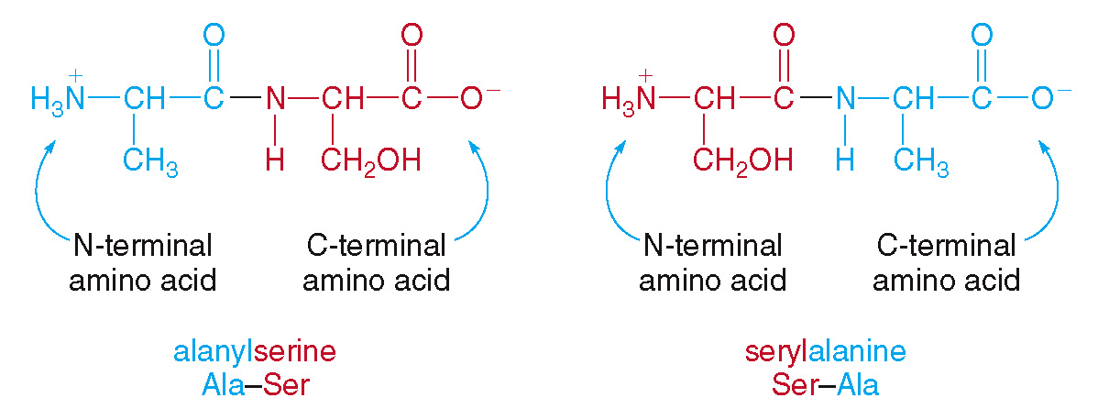
21.4 Peptides (5)
The amino acid with the free
group is the
N-terminal amino acid and is written on the left.
The amino acid with the free
group is the
C-terminal amino acid and is written on the right.

Slide 19
21.4 Peptides (6)
HOW TO Draw a Dipeptide from Two Amino Acids
Draw the structure of the dipeptide Val–Gly, and label the N-terminal and C-terminal amino acids.
Example
Step [1]
Draw the structures of the individual amino acids from left to right.
Draw valine (Val) on the left.
Draw glycine (Gly) on the right.

Slide 20
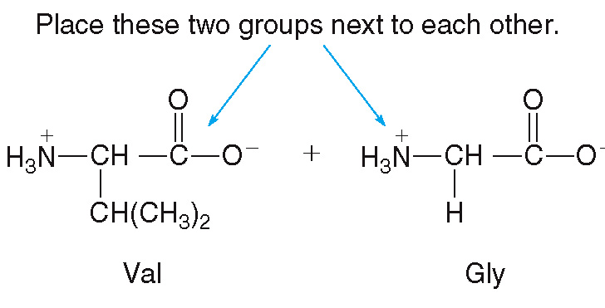
21.4 Peptides (7)
HOW TO Draw a Dipeptide from Two Amino Acids
Step [1]

Slide 21
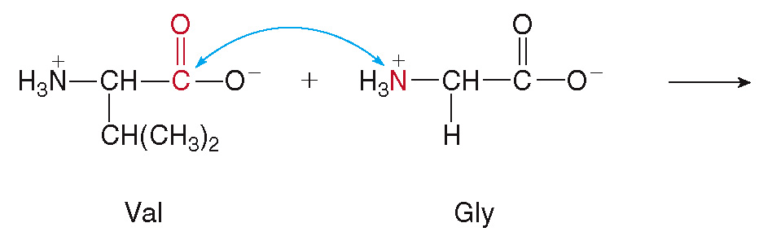
21.4 Peptides (8)
HOW TO Draw a Dipeptide from Two Amino Acids
Step [2]
Join the adjacent
and
groups.

Slide 22
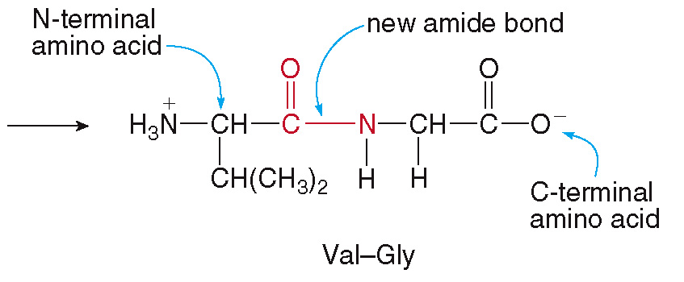
21.4 Peptides (9)
HOW TO Draw a Dipeptide from Two Amino Acids
Step [2]
Final Answer:

Slide 23
21.5 Focus on the Human Body (1)
Neuropeptides—Enkephalins and Pain Relief
Enkephalins, pentapeptides made in the brain, act as pain killers and sedatives by binding to pain receptors.
Addictive drugs morphine and heroin bind to these same pain receptors, thus producing a similar physiological response, though longer lasting.
Enkephalins belong to the family of polypeptides called endorphins, which are known for their pain reducing and mood enhancing effects.

Slide 24
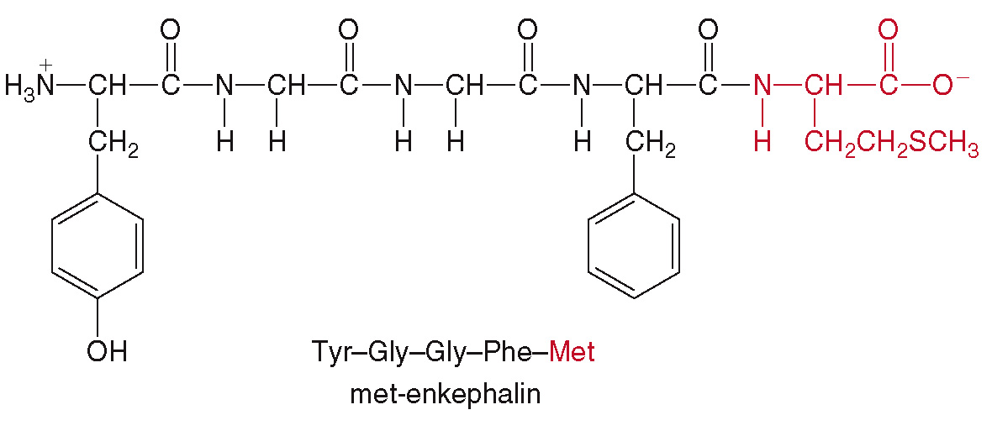
21.5 Focus on the Human Body (2)
Neuropeptides—Enkephalins and Pain Relief
One of the enkephalins, met-enkephalin:

Slide 25
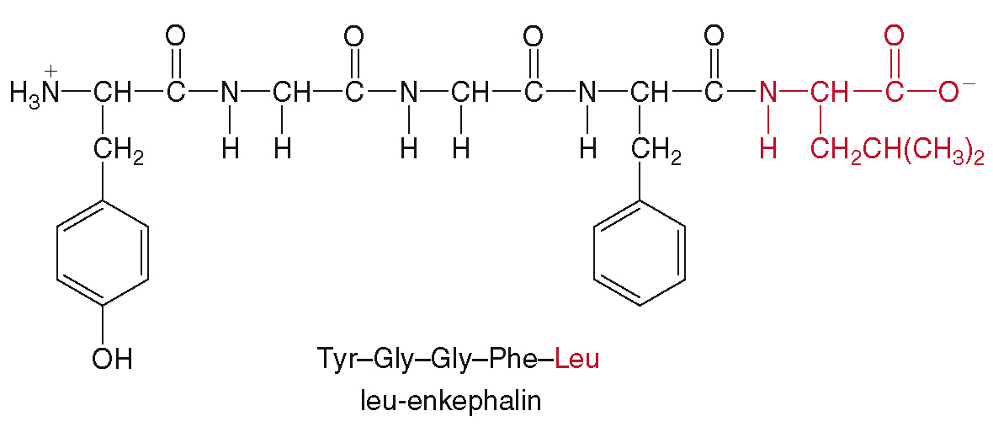
21.5 Focus on the Human Body (3)
Neuropeptides—Enkephalins and Pain Relief
The other main enkephalin, leu-enkephalin:

Slide 26
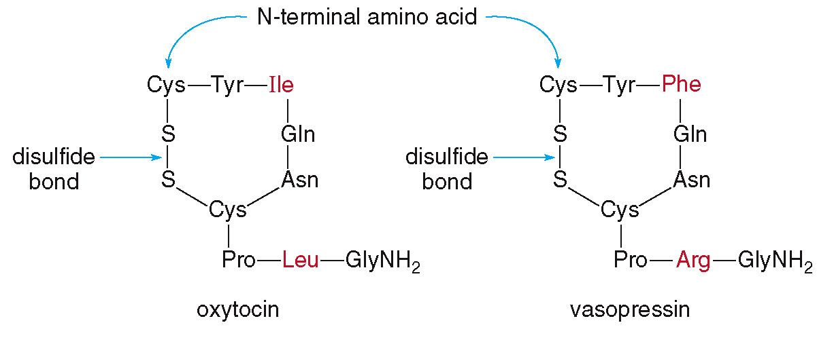
21.5 Focus on the Human Body (4)
Peptide Hormones
Oxytocin and vasopressin are cyclic nonapeptide hormones, which have identical sequences except for two amino acids.

Slide 27
21.5 Focus on the Human Body (5)
Peptide Hormones
The slightly different sequence gives the two peptides vastly different effects on the body.
Oxytocin stimulates the contraction of uterine muscles, and signals for milk production; it is often used to induce labor.
Vasopressin, antidiuretic hormone (ADH) targets the kidneys and helps to limit urine production to keep body fluids up during dehydration.

Slide 28
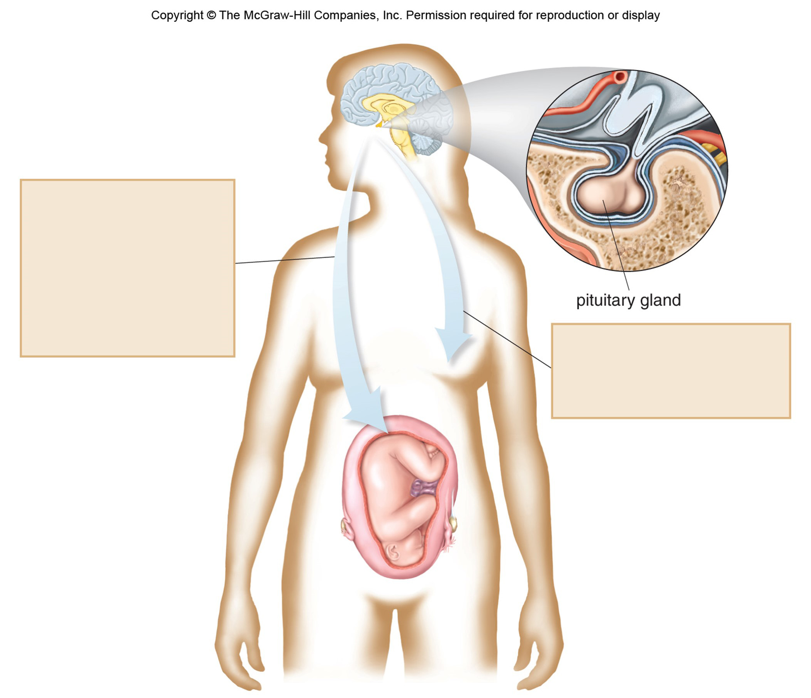
21.5 Focus on the Human Body (6)
Peptide Hormones
Oxytocin induces labor by stimulating the uterus to contract.
After delivery, oxytocin stimulates weak uterine contractions so that the uterus may return to its normal size.
Oxytocin causes weak muscle contractions in the breast, making breast milk available to a nursing infant.

Slide 29
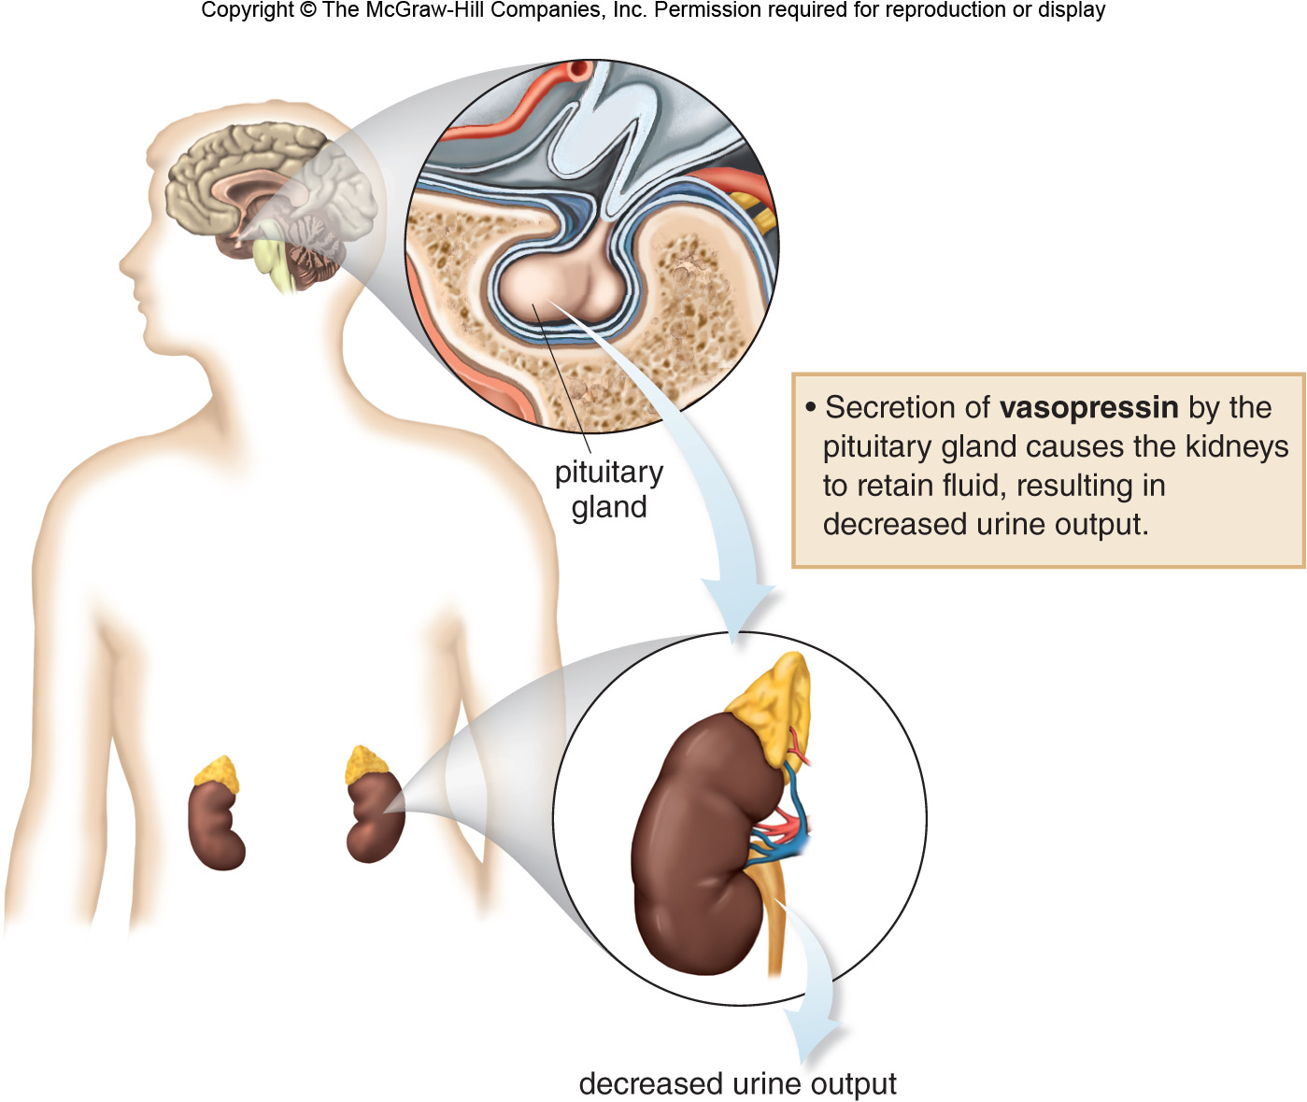
21.5 Focus on the Human Body (7)
Peptide Hormones

Slide 30
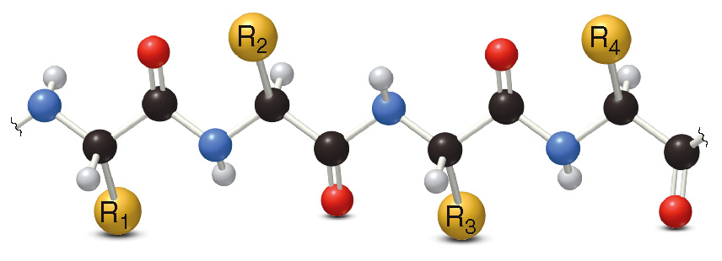
21.6 Proteins (1)
Primary Structure
The primary structure of a protein is the sequence of amino acids joined together by peptide bonds.
All bond angles are
, giving the protein a
zigzag arrangement:

Slide 31
21.6 Proteins (2)
Secondary Structure
The secondary structure is the 3D arrangement of localized regions of a protein.
These regions arise due to hydrogen bonding between the N—H group of one amide with the C═O group of another.
Two stable arrangements are the
and the
Most proteins have regions of
and
, and other regions that are random
arrangements.

Slide 32
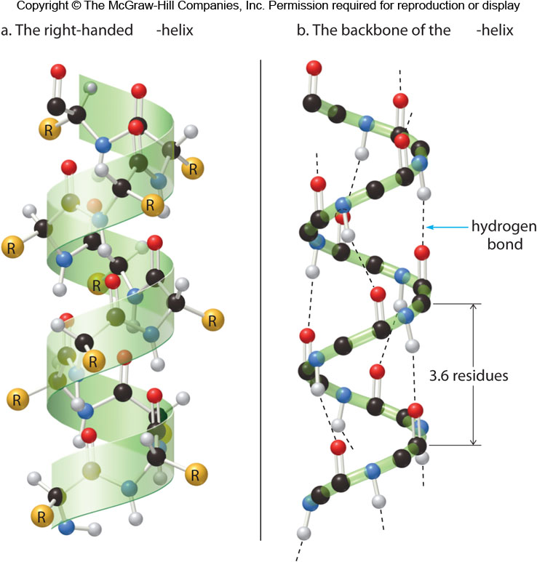
21.6 Proteins (3)
Secondary Structure
The

Slide 33
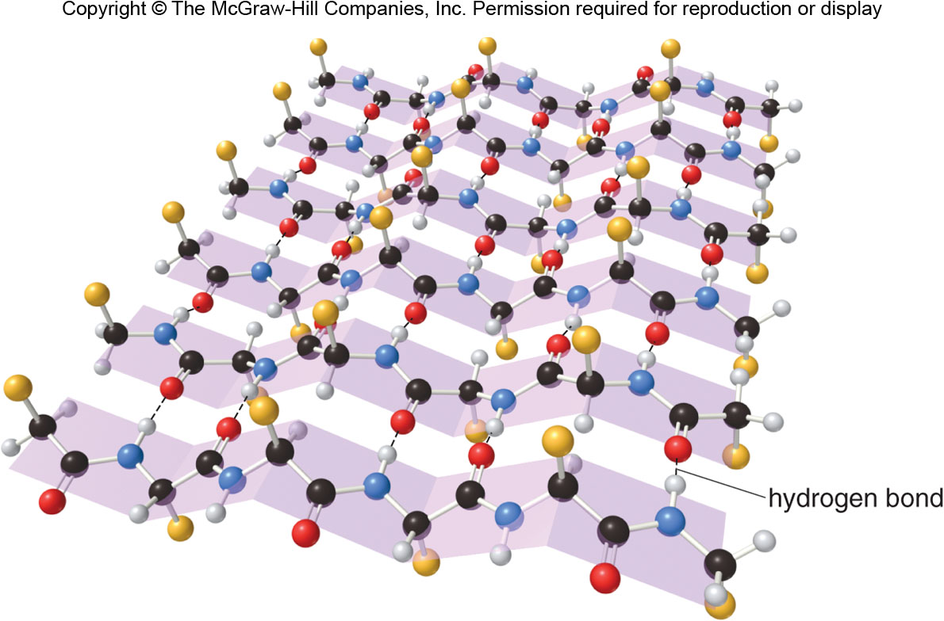
21.6 Proteins (4)
Secondary Structure
The

Slide 34
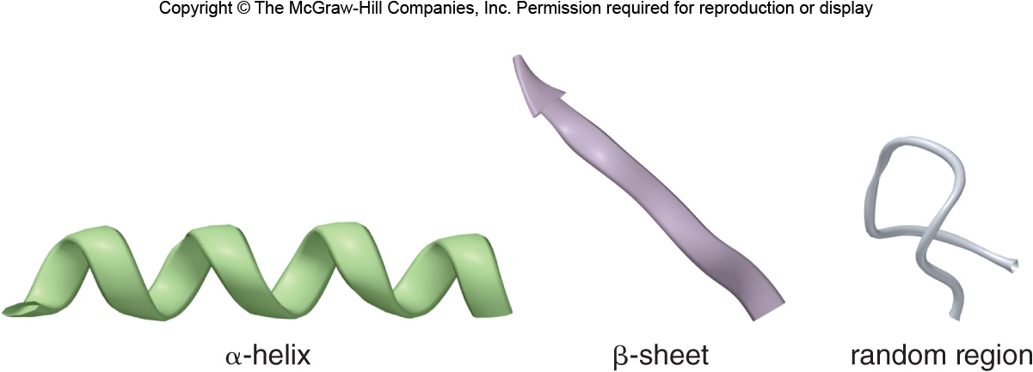
21.6 Proteins (5)
Secondary Structure
Shorthand symbols on a protein ribbon diagram:

Slide 35
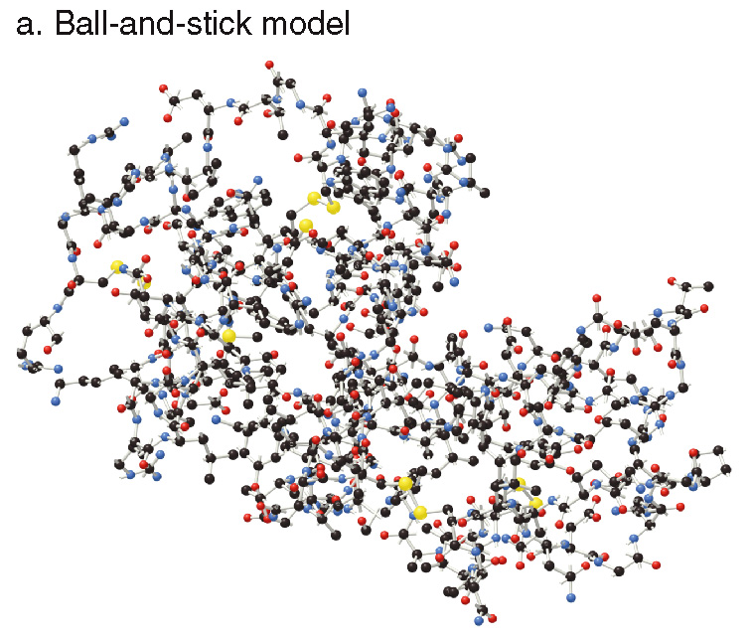
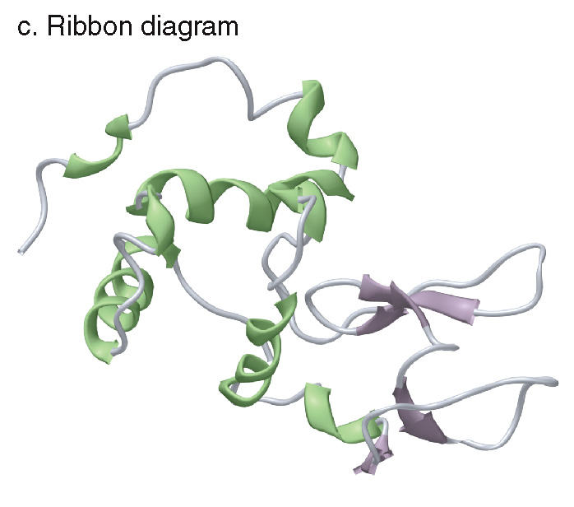
21.6 Proteins (6)
Secondary Structure

Slide 36
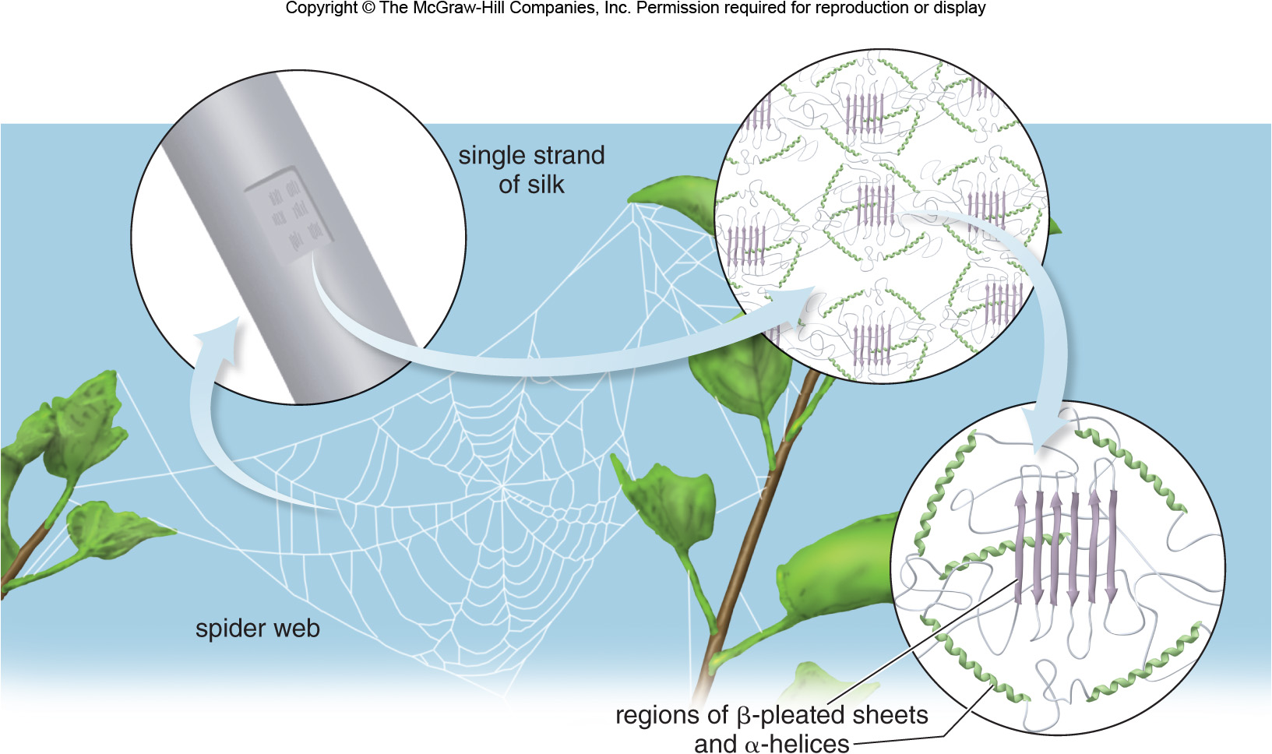
21.6 Proteins (7)
Secondary Structure

Slide 37
21.6 Proteins (8)
Tertiary and Quaternary Structure
The tertiary structure is the 3D shape adopted by the entire peptide chain.
To maximize hydrogen bonding with water, the nonpolar side chains are stabilized by London dispersion forces in the interior of the structure.
Polar functional groups can hydrogen bond to each other.
Amino acids with charged side chains are attracted by electrostatic interactions.
Disulfide bonds form covalent bonds that stabilize the tertiary structure.

Slide 38
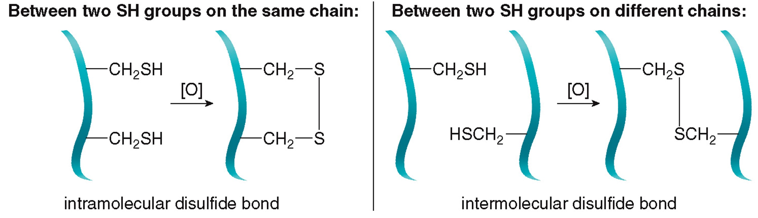
21.6 Proteins (9)
Tertiary and Quaternary Structure
Forming disulfide bonds:
Disulfide bonds can form in two different ways.

Slide 39
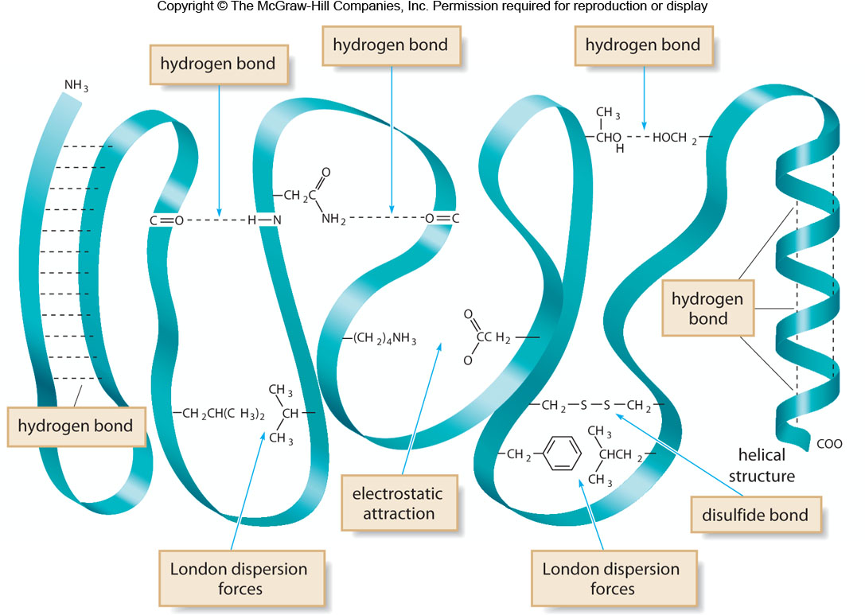
21.6 Proteins (10)
Tertiary and Quaternary Structure

Slide 40
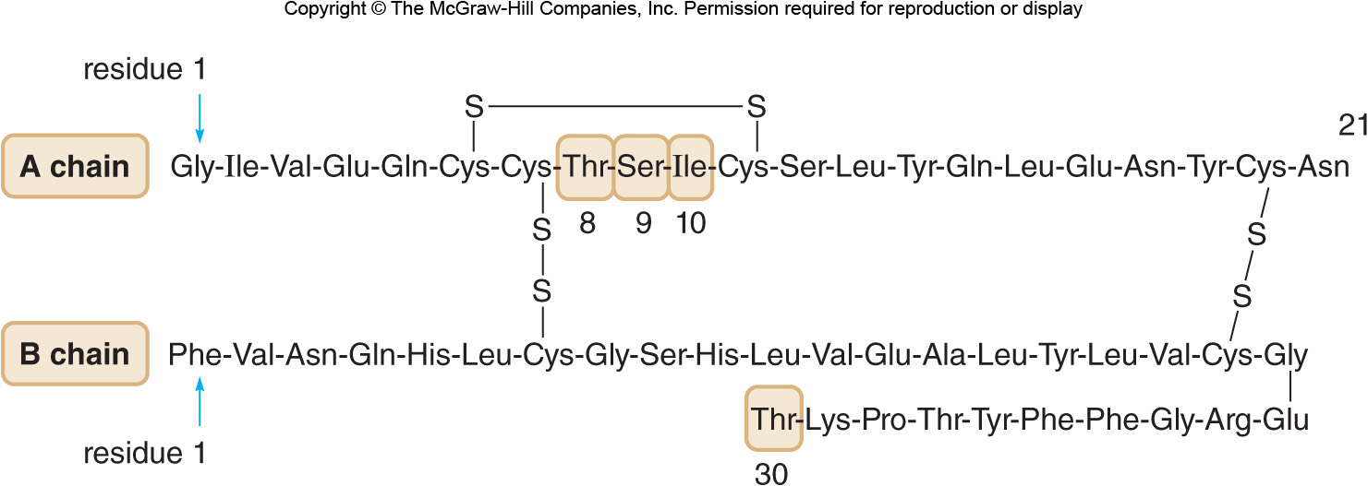
21.6 Proteins (11)
Tertiary and Quaternary Structure
The quaternary structure of the protein is the shape adopted when two or more folded poly-peptide chains come together into one complex.
Insulin consists of two separate polypeptide chains linked by intermolecular disulfide bonds.

Slide 41
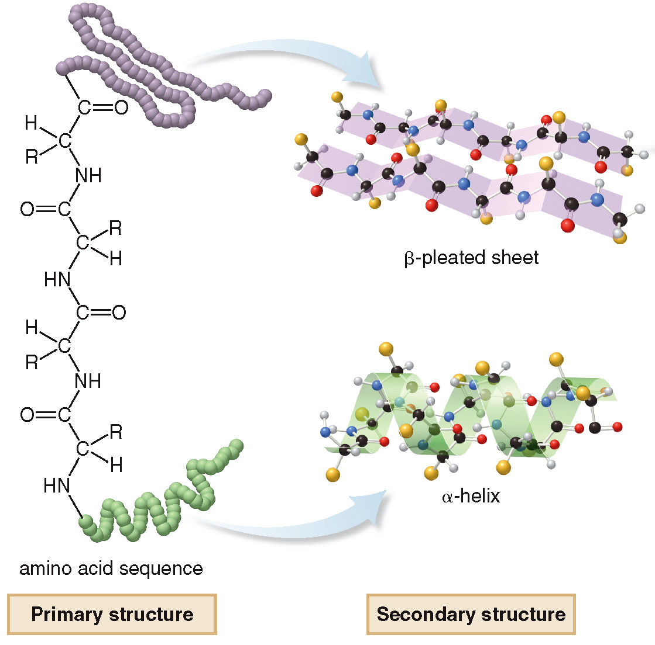
21.6 Proteins (12)
Tertiary and Quaternary Structure

Slide 42
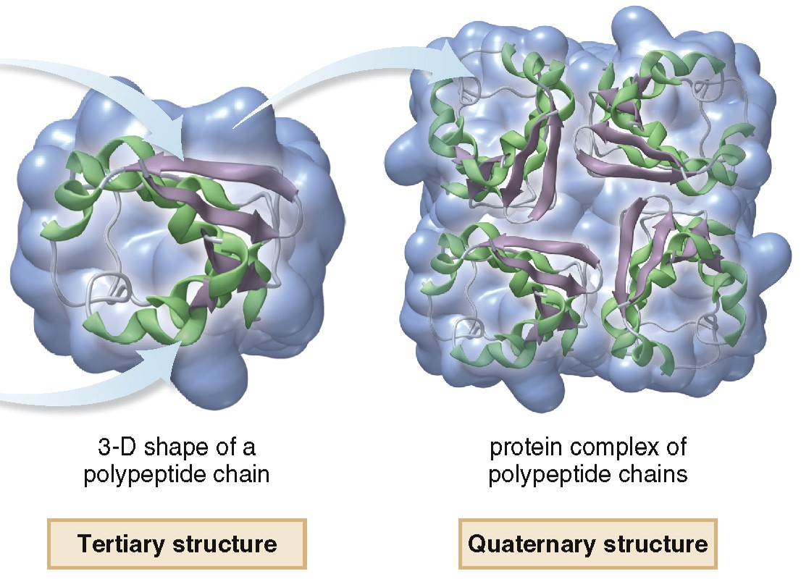
21.6 Proteins (13)
Tertiary and Quaternary Structure

Slide 43
21.7 Focus on the Human Body Common Proteins
Proteins are generally classified according to their 3D shapes.
Fibrous proteins are composed of long linear polypeptide chains that are bundled together to form rods or sheets.
Fibrous proteins are insoluble in water and serve structural roles.
Globular proteins are coiled into compact shapes that are water soluble.
Enzymes and transport proteins are globular.

Slide 44
21.7 Common Proteins (1)
are the proteins found in hair, hooves,
nails, skin, and wool.
They are made of two mainly
chains coiled
around each other in a superhelix.
These coils wind around other coils making larger and stronger structures (like hair).
Collagen requires three chains in a superhelix.
Vitamin C helps stabilize the chains, and, when missing, poorly formed collagen fibers result.

Slide 45
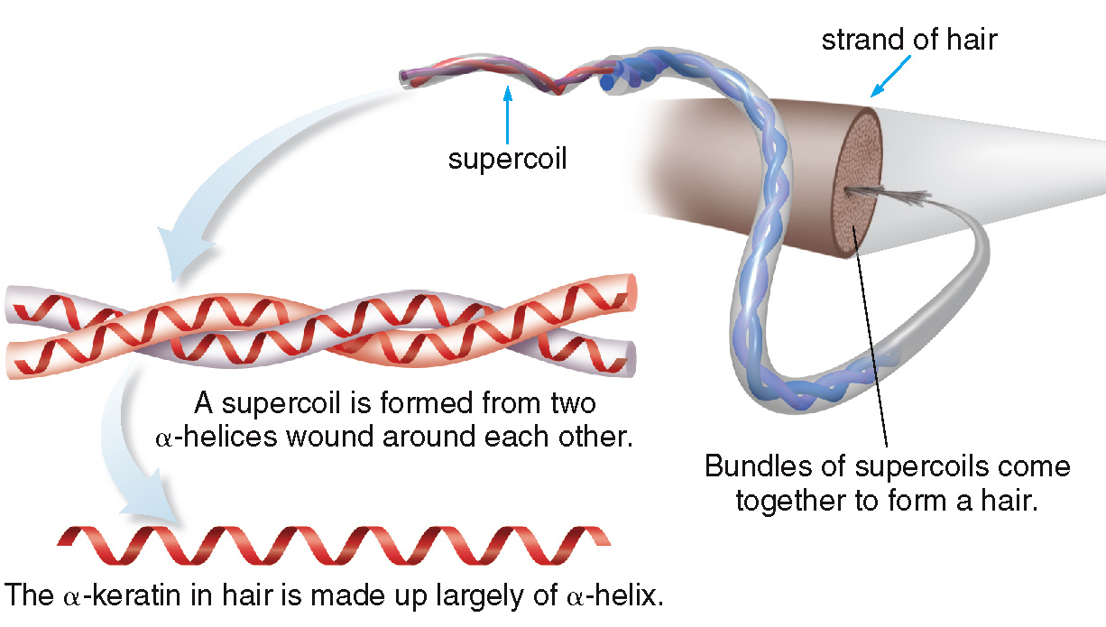
21.7 Common Proteins (2)

Slide 46
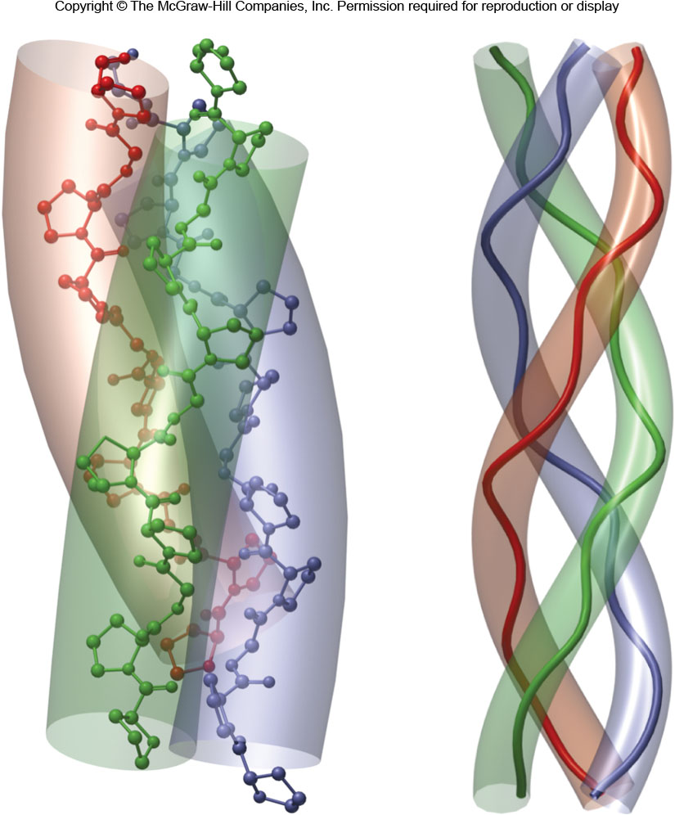
21.7 Common Proteins (3)
Collagen
Collagen’s Triple Helix:

Slide 47
21.7 Common Proteins (4)
Hemoglobin and Myoglobin
Both hemoglobin and myoglobin are globular and conjugated proteins, meaning they contain both a protein and non-protein component.
Their non-protein unit is a heme, an organic complex surrounding a
The
binds to O₂ gas in the bloodstream.
Then, the hemoglobin protein transports the
O₂ to wherever it is needed in the body.
Or, if needed, the myoglobin stores O₂ in tissues.

Slide 48
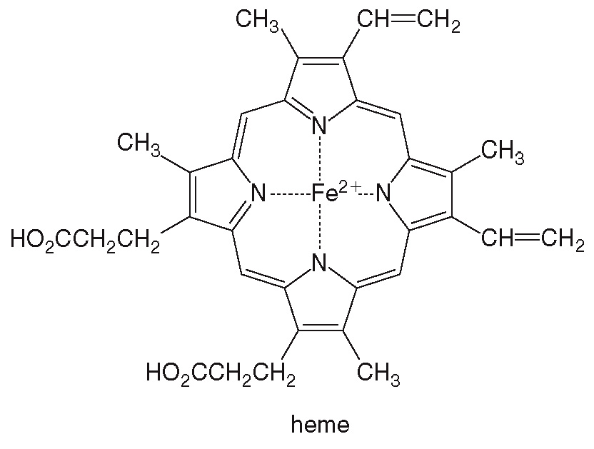
21.7 Common Proteins (5)
Hemoglobin and Myoglobin
The heme unit:

Slide 49
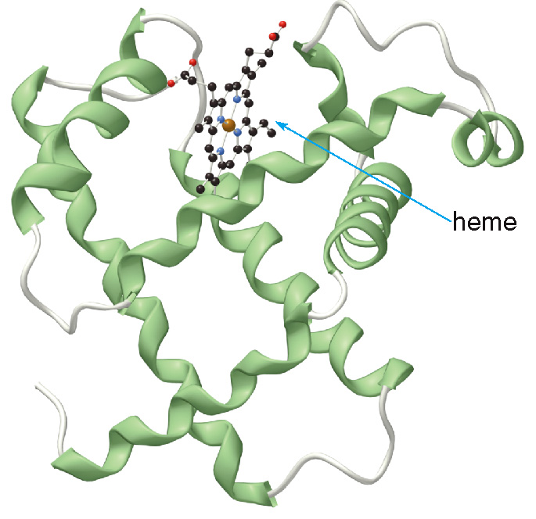
21.7 Common Proteins (6)
Hemoglobin and Myoglobin
Myoglobin has 153 amino acids in 1 polypeptide chain:

Slide 50
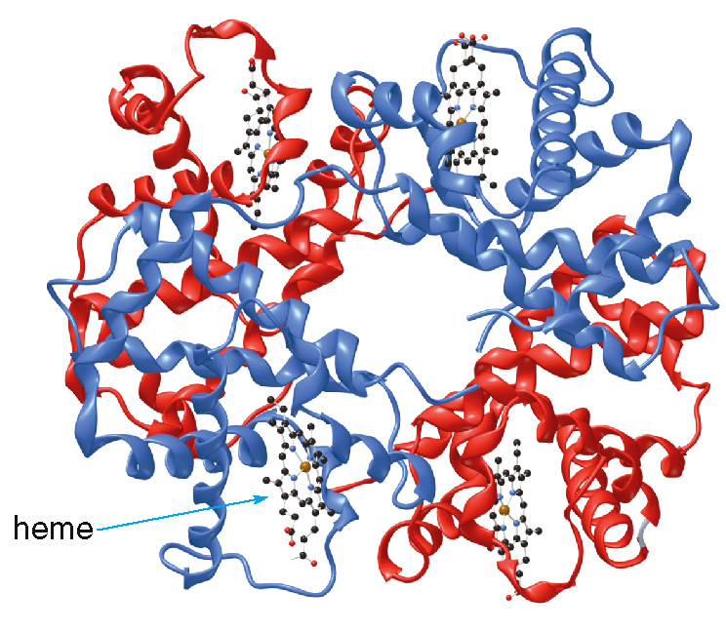
21.7 Common Proteins (7)
Hemoglobin and Myoglobin
Hemoglobin has 4 polypeptide chains, each carrying a heme unit.

Slide 51
21.7 Common Proteins (8)
Hemoglobin and Myoglobin
Carbon monoxide (CO) is poisonous because it binds 200 times more strongly to the
than
does O₂.
Hemoglobin complexed with CO cannot carry O₂, and cells will die from lack of O₂.

Slide 52
21.7 Common Proteins (9)
Hemoglobin and Myoglobin
Sickle cell anemia is a disease where a single amino acid is different in two of the subunits of hemoglobin.
Red blood cells containing these mutated hemoglobin units become elongated and crescent (sickle) shaped.
These red blood cells will rupture capillaries, causing pain and inflammation, leading to organ damage, and eventually a painful death.

Slide 53
21.8 Protein Hydrolysis and Denaturation (1)
Protein Hydrolysis
Protein hydrolysis involves breaking the peptide bonds by treatment with aqueous acid, base, or certain enzymes.
In the body, the enzyme pepsin in gastric juice cleaves some of the peptide bonds of large proteins to make smaller peptide chains.
In the intestines, enzymes trypsin and chymotrypsin hydrolyze the remainder of the amide bonds resulting in individual amino acids.

Slide 54
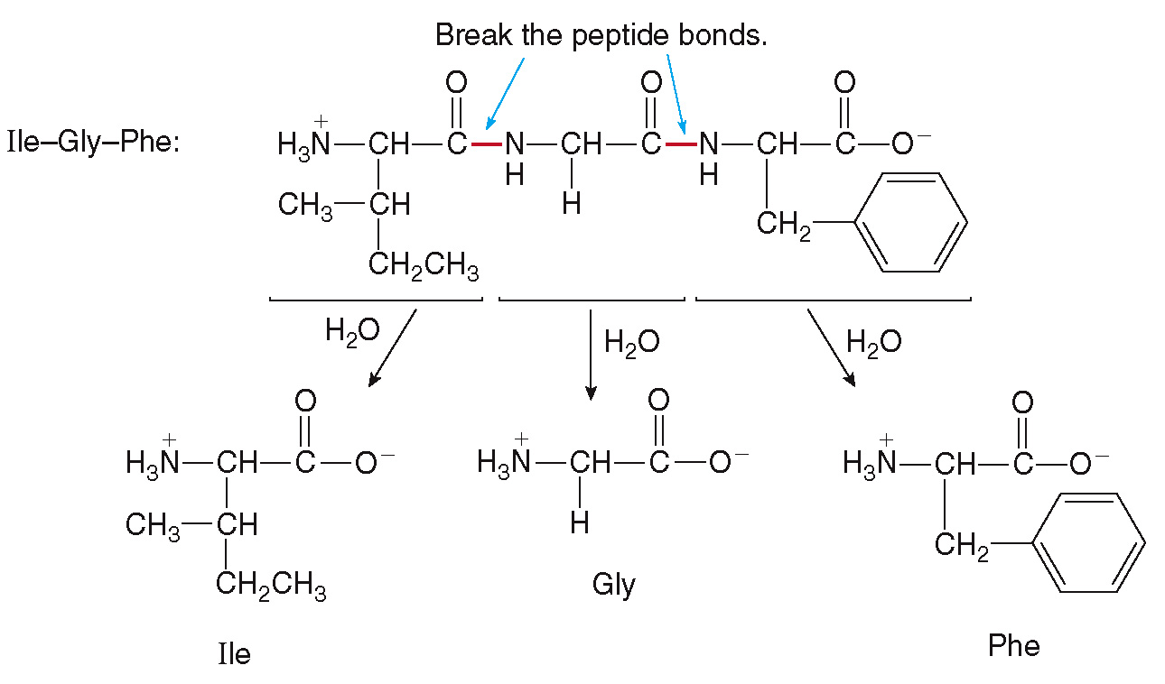
21.8 Protein Hydrolysis and Denaturation (2)
Protein Hydrolysis

Slide 55
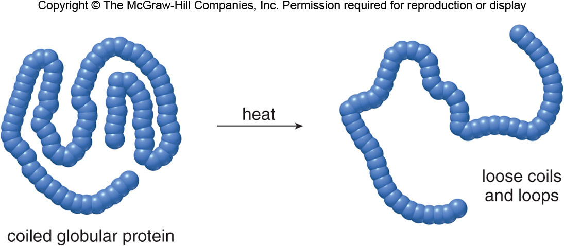
21.8 Protein Hydrolysis and Denaturation (3)
Protein Denaturation
Denaturation is the process of altering the shape of a protein without breaking the amide bonds that form the primary structure.

Slide 56
21.8 Protein Hydrolysis and Denaturation (4)
Protein Denaturation
High temperature, acid, base, and even agitation can disrupt the non-covalent interactions that hold a protein in a specific shape.
Denaturation often makes globular proteins less water soluble.
Ovalbumin, the major protein in egg white, is denatured when an egg is cooked, changing from clear and colorless to opaque and white.

Slide 57
21.9 Enzymes (1)
Characteristics of Enzymes
Enzymes are proteins that serve as biological catalysts for reactions in all living organisms.
They increase the rate of a reaction (
times faster), but are unchanged themselves.
Enzymes are very specific; each enzyme catalyzes a certain reaction or type of reaction only.
The names of most enzymes end with the suffix
“-ase” like peptidase, lipase, and hydrolase.
A cofactor is a metal ion or an organic molecule needed for an enzyme-catalyzed reaction to occur.

Slide 58
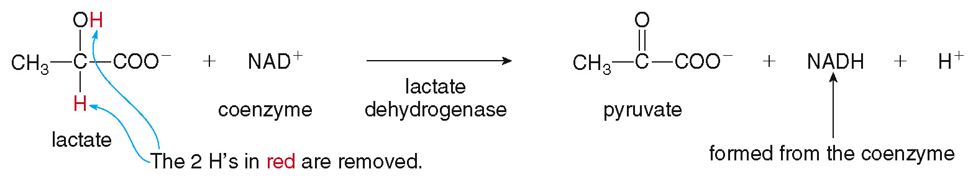
21.9 Enzymes (2)
Characteristics of Enzymes
is the cofactor (coenzyme) that oxidizes
lactate to pyruvate with the aid of the enzyme lactate dehydrogenase:

Slide 59
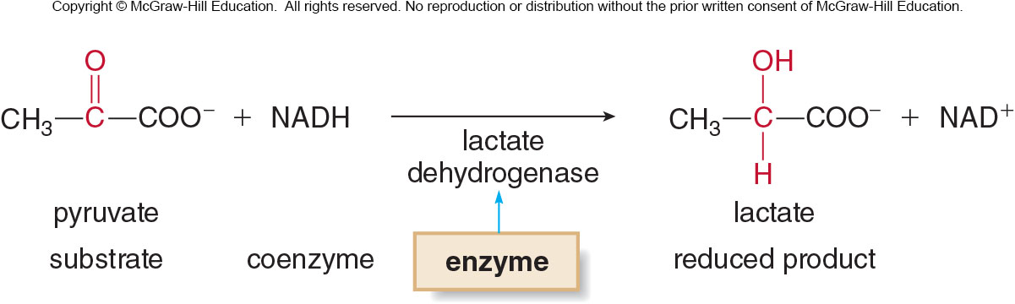
21.9 Enzymes (3)
Classification of Enyzmes
Enzymes are classified into six categories by the type of reaction they catalyze.
Oxidoreductases catalyze oxidation-reduction reactions.
When a substrate is oxidized or reduced, a coenzyme is required, which serves are the oxidizing or reducing agent.

Slide 60
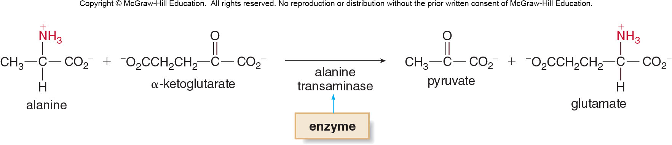
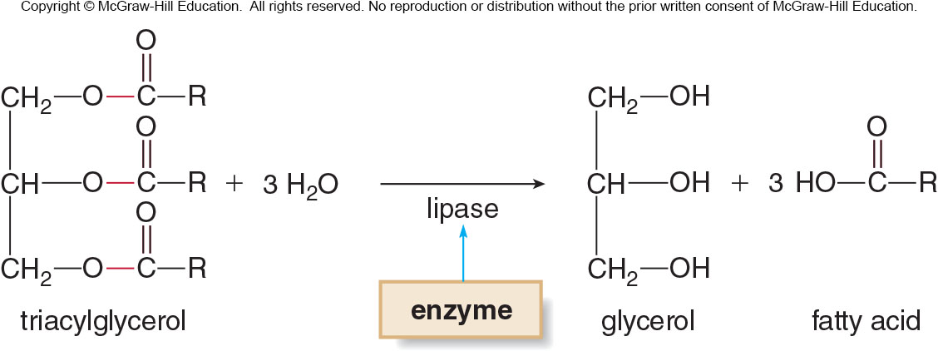
21.9 Enzymes (4)
Classification of Enyzmes
Transferases catalyze the transfer of a group from one molecule to another.
Hydrolases catalyze hydrolysis reactions – the cleavage of bonds with water.

Slide 61
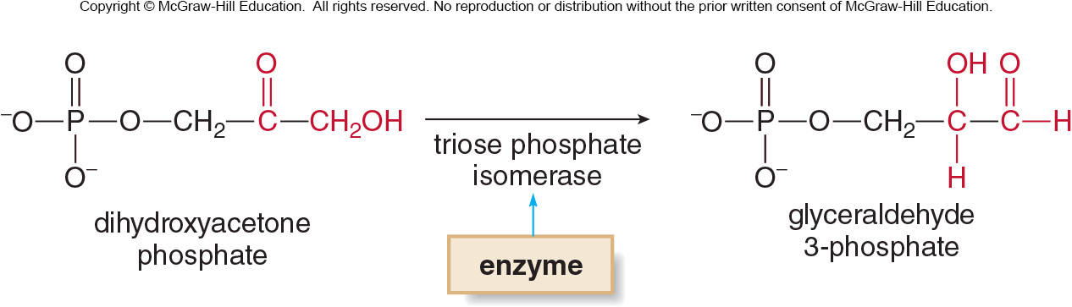
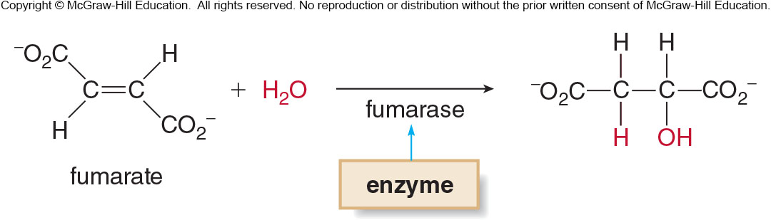
21.9 Enzymes (5)
Classification of Enyzmes
Isomerases catalyze the conversion of one isomer to another.
Lyases catalyze the addition of a molecule to a double bond or the elimination of a molecule to give a double bond.

Slide 62
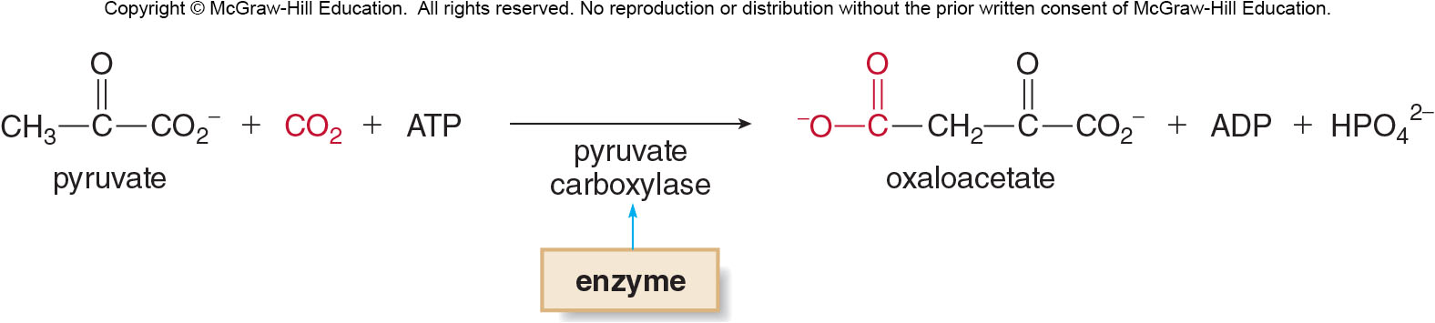
21.9 Enzymes (6)
Classification of Enyzmes
Ligases catalyze bond formation accompanied by energy release from a hydrolysis reaction.
This process is energetically unfavorable, so the energy released in a hydrolysis reaction is used to drive the reaction.

Slide 63
21.9 Enzymes (7)
Classification of Enyzmes
Table 21.3 Classification of Enzymes
Enzyme Class or Subclass | Reaction Catalyzed
Oxidoreductases Oxidases Reductases Dehydrogenases | Oxidation-reduction Oxidation Reduction Addition or removal of 2 H’s
Transferases Transaminases Kinases | Transfer of a group Transfer of an NH₂ group Transfer of a phosphate
Hydrolases Lipases Proteases Nucleases | Hydrolysis Hydrolysis of lipid esters Hydrolysis of amide bonds in proteins Hydrolysis of nucleic acids
Isomerases | Isomerization
Lyases Dehydrases Decarboxylases Synthases | Addition to a double bond or elimination to give a double bond Removal of H₂O Removal of CO₂ Addition of a small molecule to a double bond
Ligases Carboxylases | Bond formation accompanied by ATP hydrolysis Bond formation between a substrate and CO₂

Slide 64
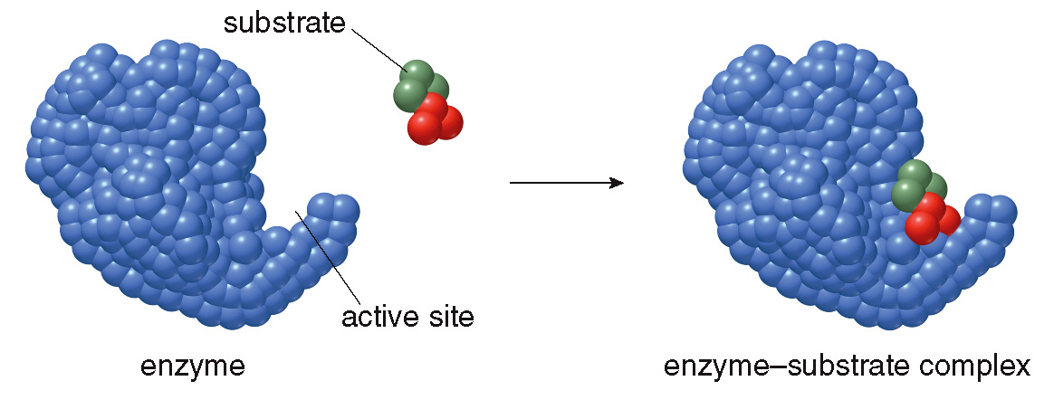
21.10 How Enzymes Work (1)
An enzyme contains an active site that binds the substrate, forming an enzyme-substrate complex.

Slide 65

21.10 How Enzymes Work (2)
Enzyme Specificity
Once the reaction has occurred, the catalyst released the product(s).
Two models have been proposed to explain the specificity of a substrate for an enzyme’s active site.

Slide 66

21.10 How Enzymes Work (3)
Enzyme Specificity
The lock-and-key model states that the active site is a rigid cavity; to react, the substrate must exactly match the shape of the active site.

Slide 67

21.10 How Enzymes Work (4)
Enzyme Specificity
The induced-fit model states that the active site has a flexible shape, which can adjust to fit a variety of substrate shapes.

Slide 68

21.10 How Enzymes Work (5)
Enzyme Specificity
Shape of the active site before binding
Shape of the active site after binding
The open cavity of the active site of the enzyme closes around the substrate for a tighter fit.

Slide 69
21.10 How Enzymes Work (6)
Factors That Affect Enzyme Activity
The activity of an enzyme is affected by both temperature and pH.
An increase in temperature increases the rate of most chemical reactions (Section 6.4).
Enzyme-catalyzed reactions also exhibit an increase in rate with increasing temperature until a maximum activity occurs, usually around
Each enzyme has an optimum pH at which catalysis occurs at a maximum rate.

Slide 70
21.10 How Enzymes Work (7)
Allosteric Control
Allosteric control is the binding of a regulator to a site on an enzyme that affects the enzyme’s ability to bind a substrate at its active site.
Negative allosteric control occurs when a regulator makes the active site less able to bind the substrate, and the rate of reaction decreases.
Positive allosteric control occurs when a regulator makes the active site more able to bind the substrate, and the rate of the reaction increases.

Slide 71

21.10 How Enzymes Work (8)
Allosteric Control

Slide 72
21.10 How Enzymes Work (9)
Enzyme Inhibitors
Substances that bind to an enzyme and in the process greatly alter or destroy the enzyme’s activity are called inhibitors.
A reversible inhibitor binds to an enzyme but then enzyme activity is restored when the inhibitor is released.
An irreversible inhibitor covalently binds to an enzyme, permanently destroying its activity..

Slide 73

21.10 How Enzymes Work (10)
Enzyme Inhibitors
Penicillin is an antibiotic that kills bacteria because it irreversibly binds to the enzyme required for the synthesis of a bacterial cell wall (Section 17.11).
Penicillin has no effect on human cells because they are surrounded by a cell membrane.

Slide 74
21.10 How Enzymes Work (11)
Enzyme Inhibitors
Reversible can be competitive or noncompetitive.
A noncompetitive inhibitor bonds to the enzyme, but not to the active site.
A competitive inhibitor has a shape and structure similar to the substrate, so it competes with the substrate for binding to the active site.

Slide 75

21.10 How Enzymes Work (12)
Enzyme Inhibitors

Slide 76

21.10 How Enzymes Work (13)
Zymogens
Zymogens (proenzymes) are an inactive form of an enzyme that can be converted to the active form when needed.

Slide 77
21.11 Focus on Health & Medicine (1)
Enzyme Levels as Diagnostic Tools
Certain enzymes are present in higher amounts in particular cells, which can be detected if these cells rupture and die.
Table 21.4 Common Enzymes Used for Diagnosis
Enzyme | Condition
Creatine phosphokinase | Heart attack
Alkaline phosphatase | Liver or bone disease
Acid phosphatase | Prostate cancer
Amylase, lipase | Diseases of the pancreas

Slide 78

21.11 Focus on Health & Medicine (2)
Drugs that Interact with Enzymes
Penicillin inhibits the enzyme that forms cell walls of bacteria, destroying the bacterium.
ACE (angiotensin-converting enzyme) causes blood vessels to narrow, increasing blood pressure.
ACE inhibitors are given to those with high blood pressure to prevent ACE’s synthesis from it’s zymogen.

Slide 79

21.11 Focus on Health & Medicine (3)
Drugs that Interact with Enzymes
HIV protease is an essential enzyme that allows the virus to make copies of itself.
HIV protease inhibitors interfere with this copying, decreasing the virus population in the patient.
Ball-and-stick model of the HIV protease enzyme
Ribbon diagram with the protease inhibitor amprenavir in the active site

